Slide 1
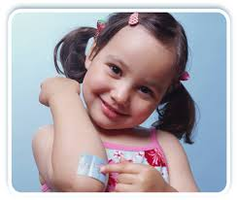
Emergencies in children
Bapa Refresher Course 2016
Dr Sanchez Torres Cristel
Cliniques Universitaires Saint-Luc (Brussels, Belgium)

Slide 2
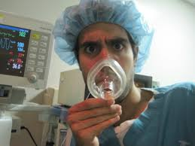
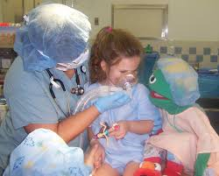
Emergencies in children…Why is it so scary ????
Lovely time for pediatrics
versus
Hyperventilation in non pediatric colleagues

Slide 3
Why?
Pediatric perioperative cardiac arrest (USA)
1.4 / 100 000 anesthesias
Mortality in cardiac arrest = 26%
Emergencies and <1 year
Loss of airway = most common cause of cardiac arrest in children
Pediatric concerns
Smaller CRF, rapid desaturation, laryngospasm, preoxygenation
difficult IV line placement, intubation not easy in smaller kids
syndromes ou non symptomatic cardiac and respiratory abnormalities

Slide 4
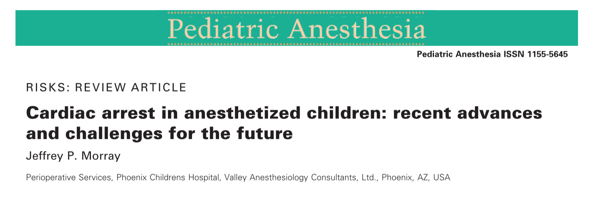
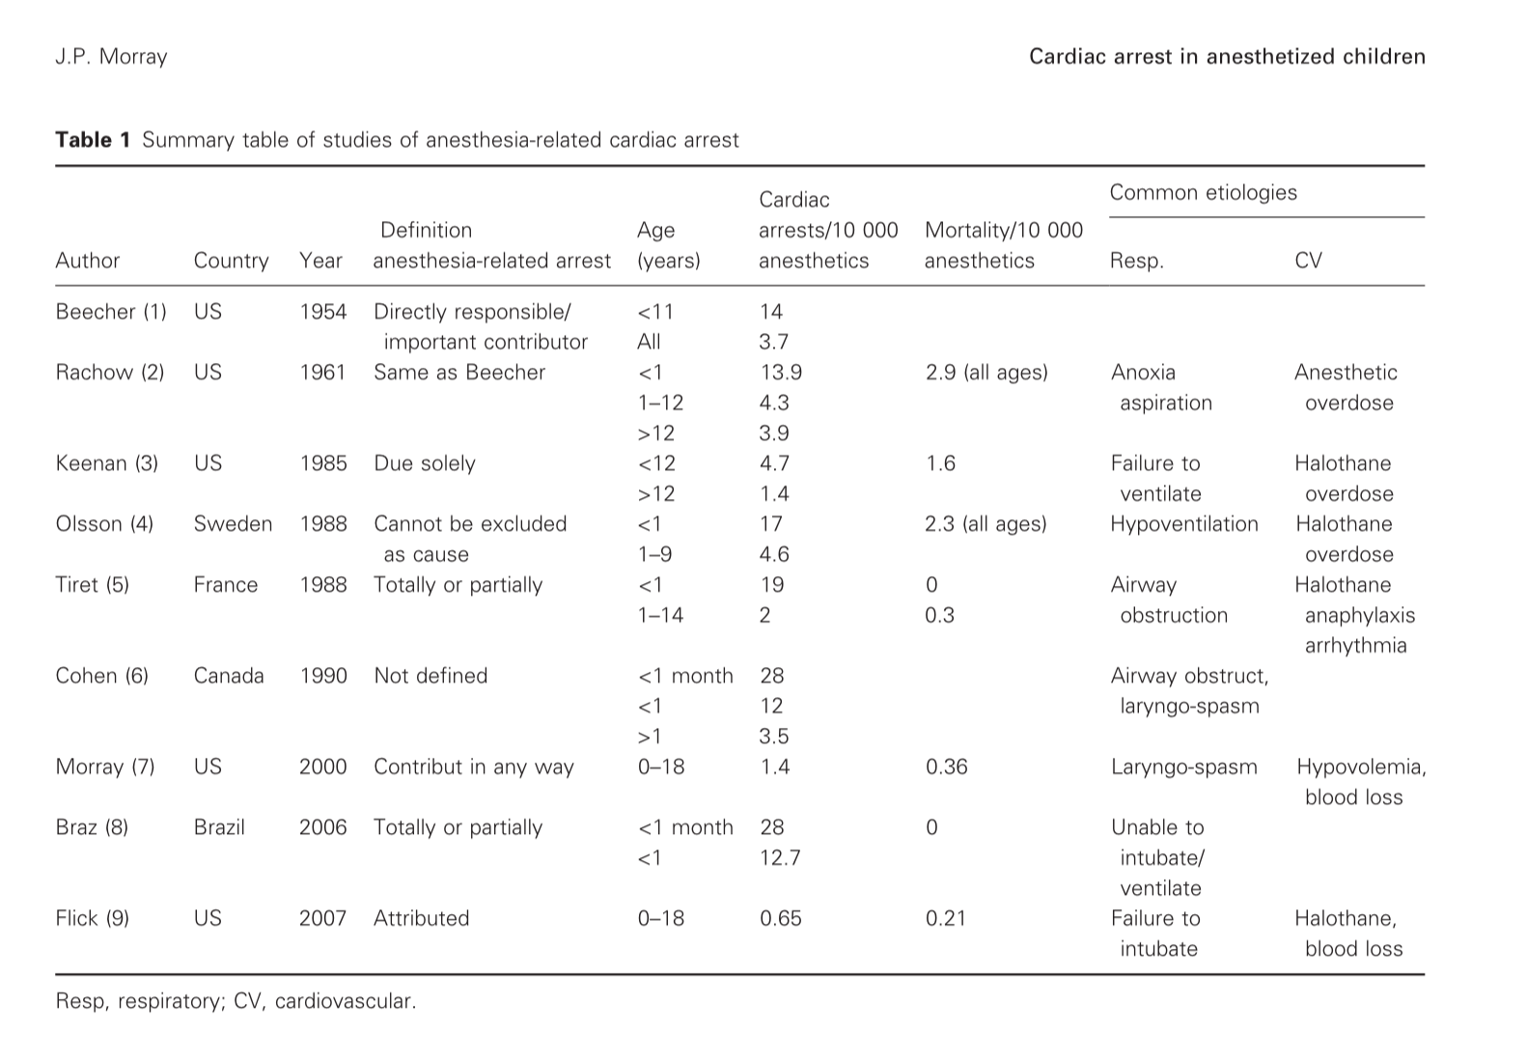
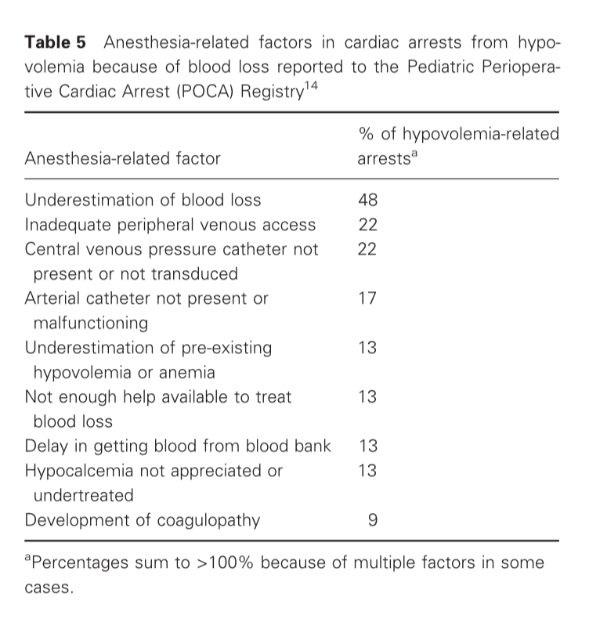
Pediatric cardiac arrest

Slide 5
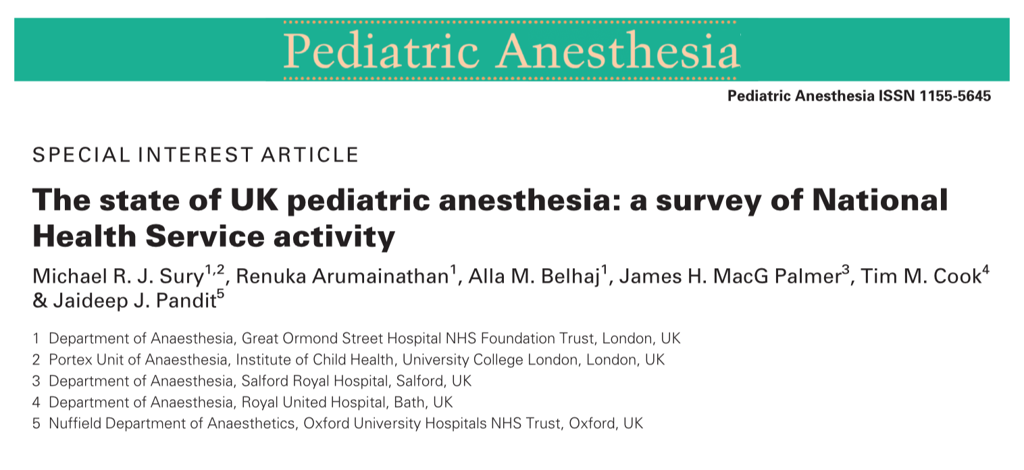
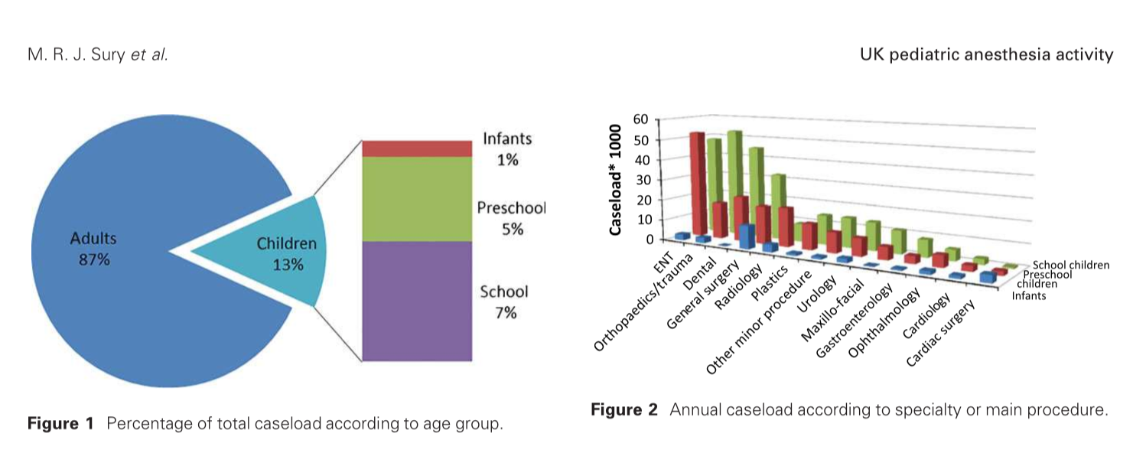
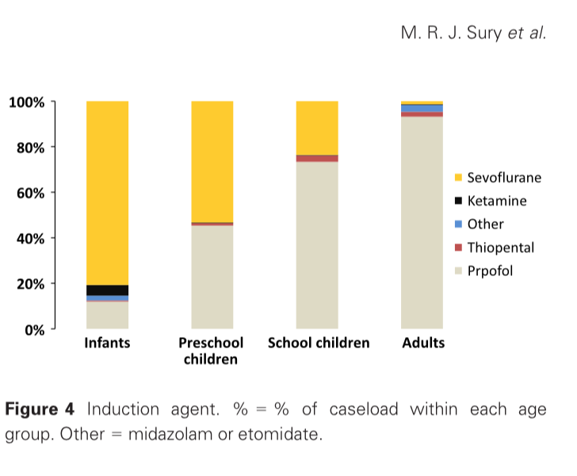
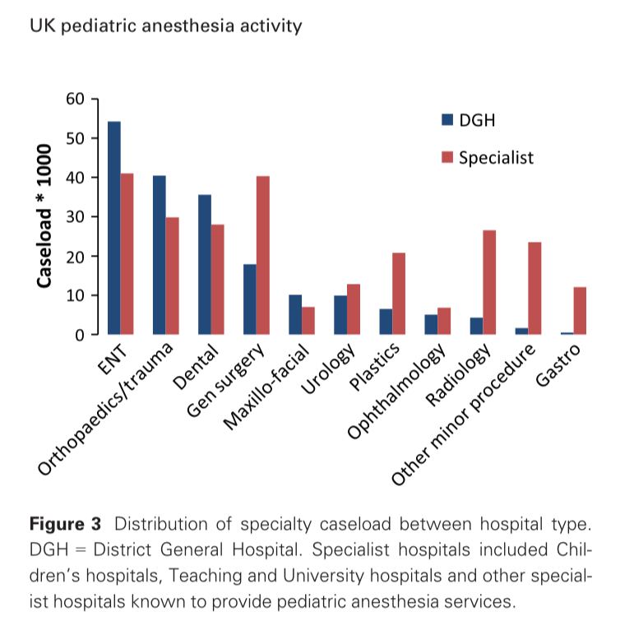
UK

Slide 6
Emergencies in children
Role of anesthetist/team
Some skills to have and to maintain
Pediatric equipment needed
« Complication rate is low despite many areas of ped. emergencies remain controversial »
Davidson A., Anesthetic management of common pediatric emergencies, Curr Opin Anaesthesiol. 2013 Jun, 26 (3):304-9
McDougall R.J., Paediatric emergencies, Anesthesia 2013, 68 (Suppl.1), 61-71

Slide 7
Fasting and emergencies
Emergencies and recent dietary intake, occlusive syndrome, vomiting,…
!!!Gastro-oesophageal reflux, Nissen procedure in the history oro-oesophageal atresia repaired,…!!!
Trauma and stress : « … aspirates is larger in children injured within 2 hours of eating… » Bricker SR, Gastric aspirates after trauma in children. Anaesthesia1989
Majority of inhalational incidents occurs at the induction and 2/3 of them before the laryngoscopy (1 in 1162 children, 3x than adults) (OlssonGL. Aspiration during anaesthesia : a computer aided study of 185 385 anaesthestics. Acta Anaesthesiol Scand 1986; 30 : 80-92)
In adults, complications of gastric inhalation are responsible of 10 to 30% of the deaths due to anesthesia
Sellick / Cricoid pressure…. Not completely effective Landrau B, Inhalation gastrique: epidemiologie et facteurs de risque. Ann Fr Anesth Réanim 2009; 28:206-10

Slide 8
Rapid Sequence Induction
Pulmonary aspiration is rare but feared as anesthesia complication
Preoxygenation, thiopentone, suxamethonium, no positive pressure ventilation and quick intubation
Young children more susceptible to hypoxemia than older children and than adults (Xue FS, Luo LK, Tong SY et al. Study of the safe treshold of apneic period in children during anesthesia induction. J Clin Anesth 1996; 8:568-574)
Hypoxemia more frequent in emergencies (increased metabolic rate, abdominal pathology decreasing functional residual capacity, upper respiratory tract infection,…) (Kinouchi K. Duration of apnea in anesthestized infants and children required for desaturation of Hb to 95%-the influence of upper respiratory infection. Anesthesiology 1992; 77: 1105-1107)

Slide 9
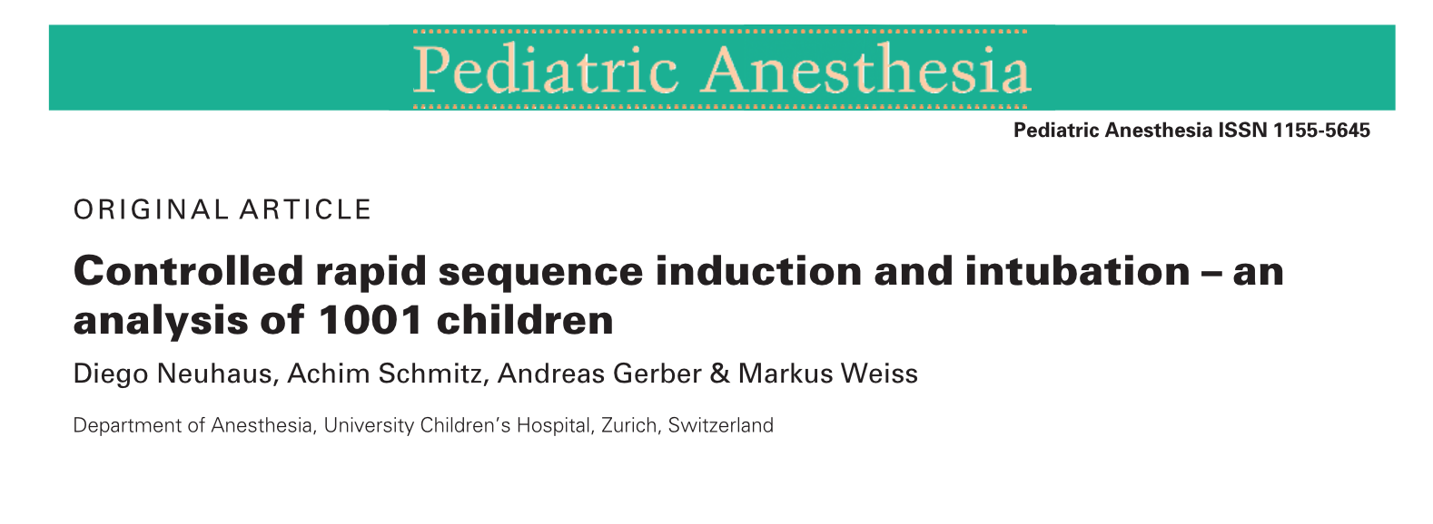
Modified rapid controlled sequence in children
1001 patients
Moderate hypoxemia in 0.5%
Severe hypoxemia in 0.3%
No bradycardia or hypotension
One single gastric regurgitation but no pulmonary aspiration detected

Slide 10
Modified Rapid Sequence Induction
Preoxygenation
Titration of hypnotic and analgesic
+/- cricoïd pressure
Gentil ventilation (<15 cm H2O)
Muscle relaxant
Laryngoscopy
Intubation
Less hypoxia
Less hypotension
Intubation in good conditions
Less stress

Slide 11
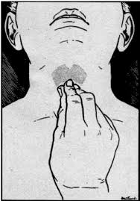
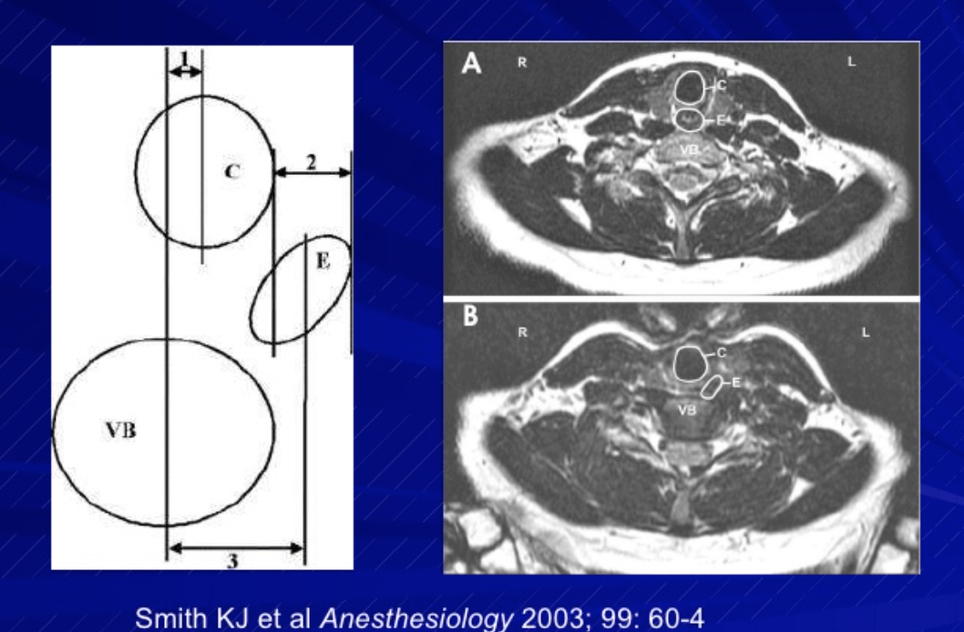
Cricoid pressure
Popularized in 1961 by Sellick
No randomized , no controlled trials
Radiologic evidences suggests that cricoïd that may not occlude completely the esophagus
He doesn’t describe the force that we should applied ( 40N for adults, 5N in infants and 12N in children) distortion of the airway

Slide 12
Cricoïd Pressure and MRI

Slide 13
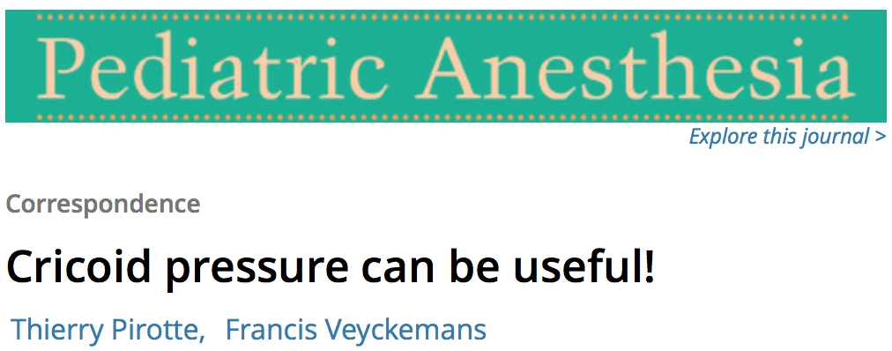
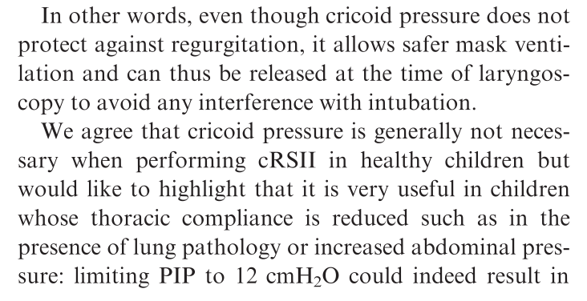
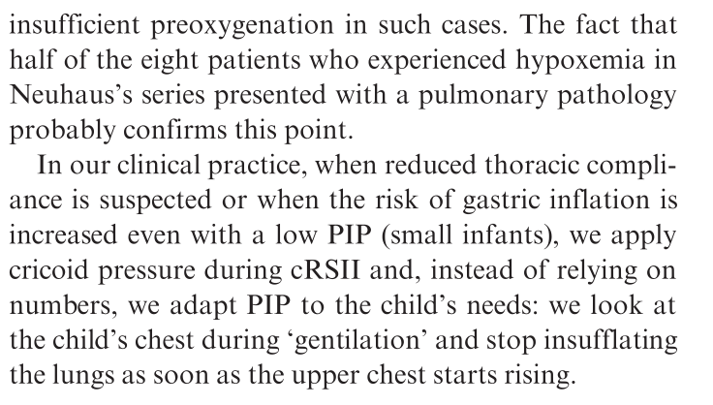
Cricoïd pressure

Slide 14
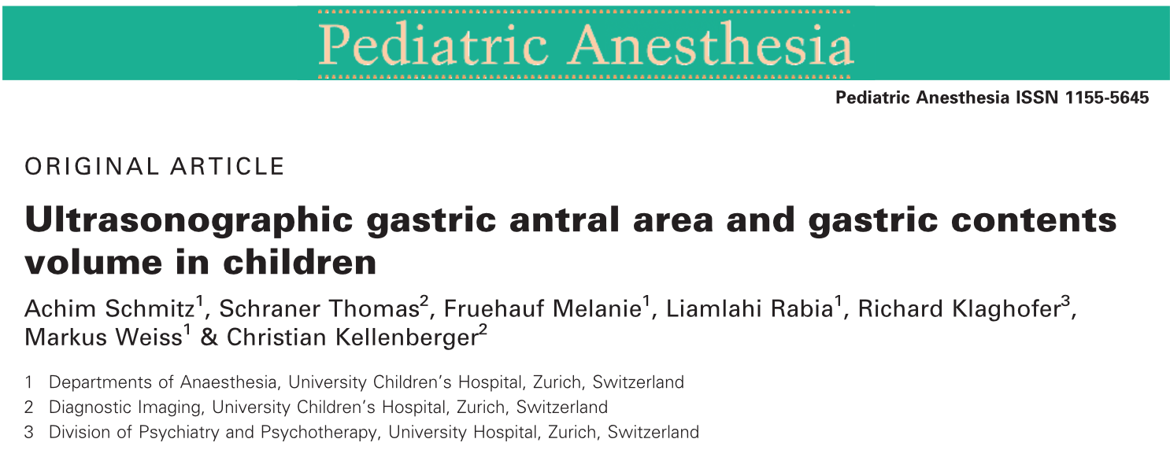
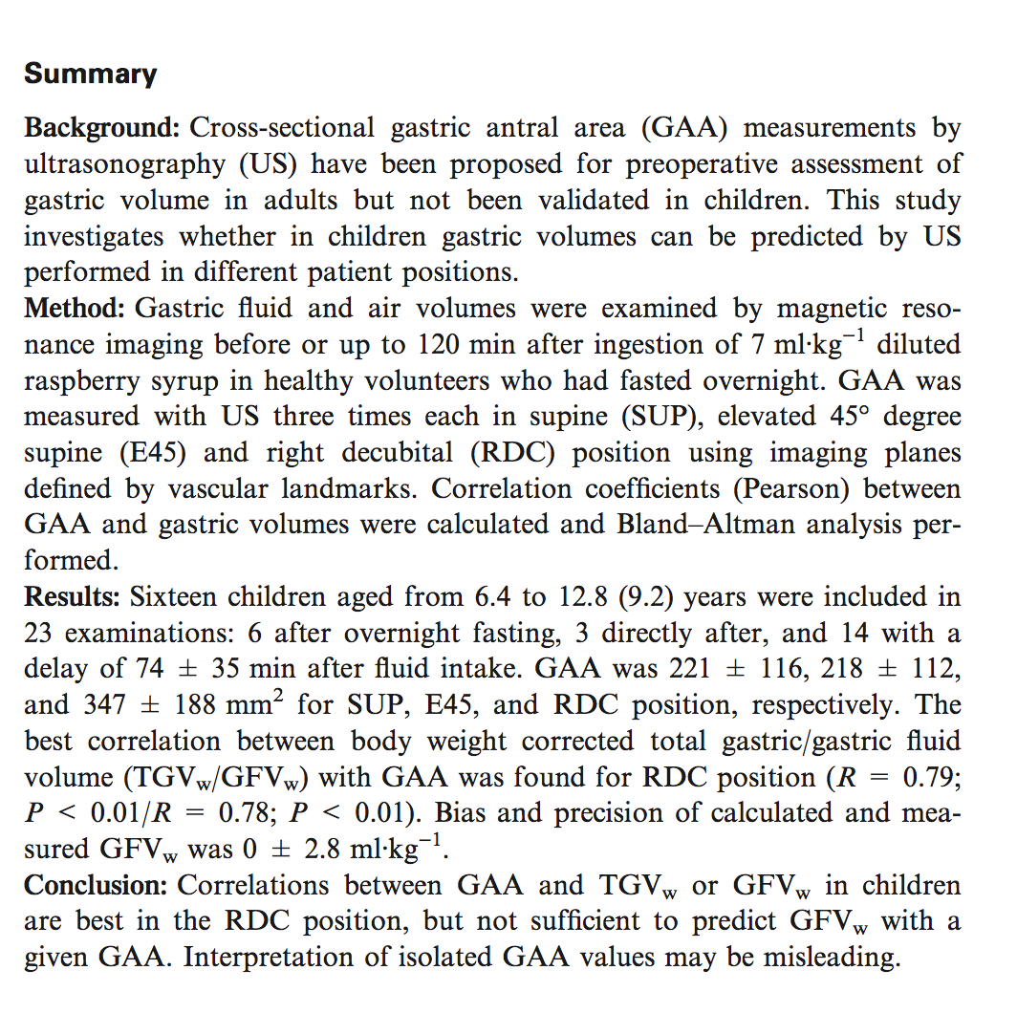
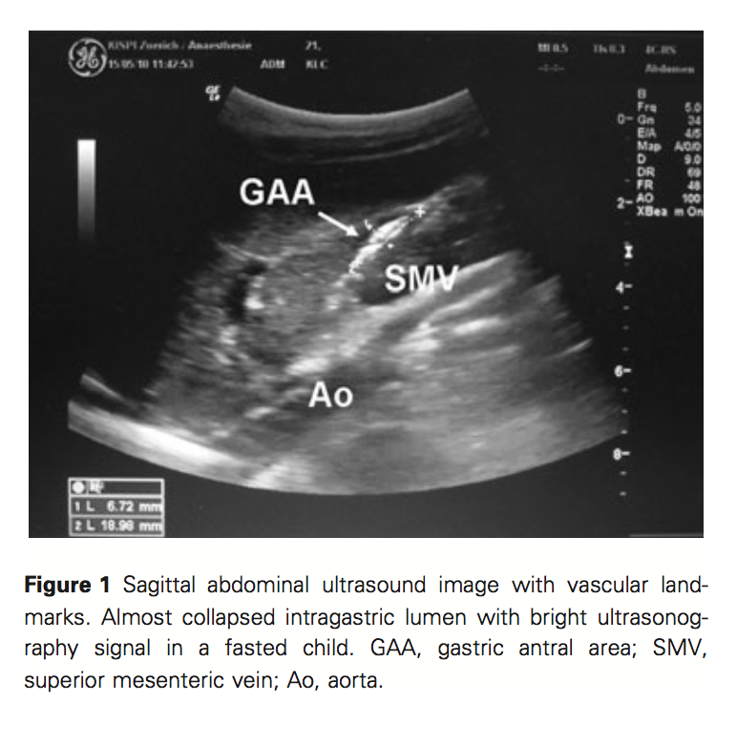
Echography can help!

Slide 15
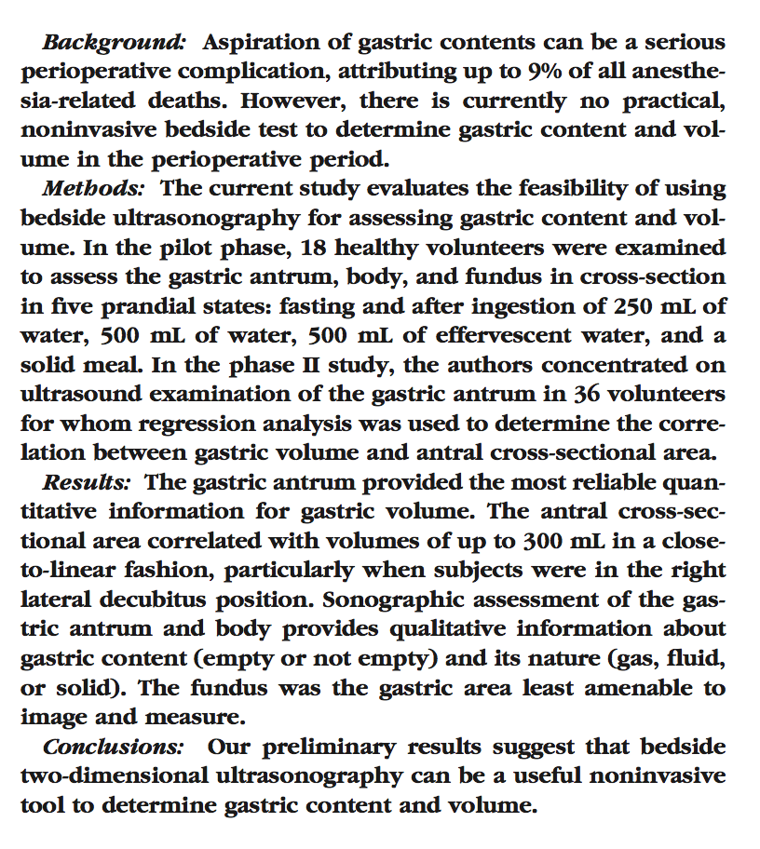
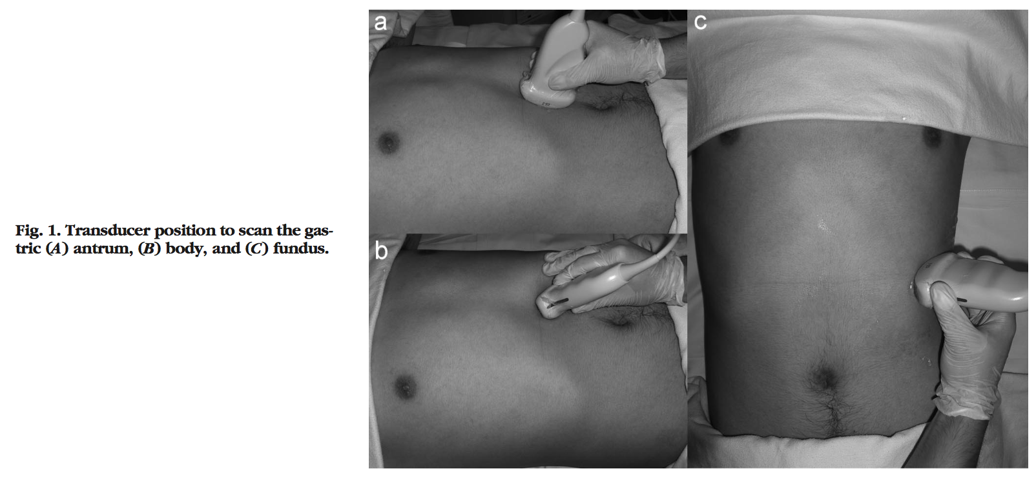

Slide 16
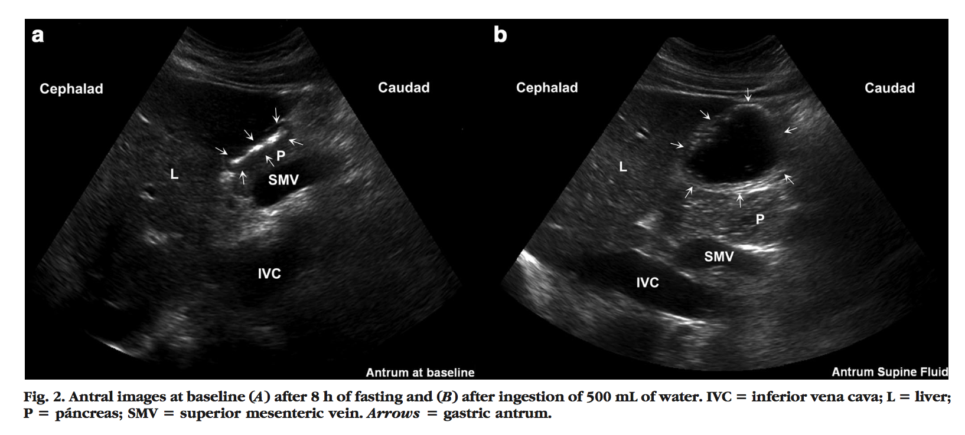
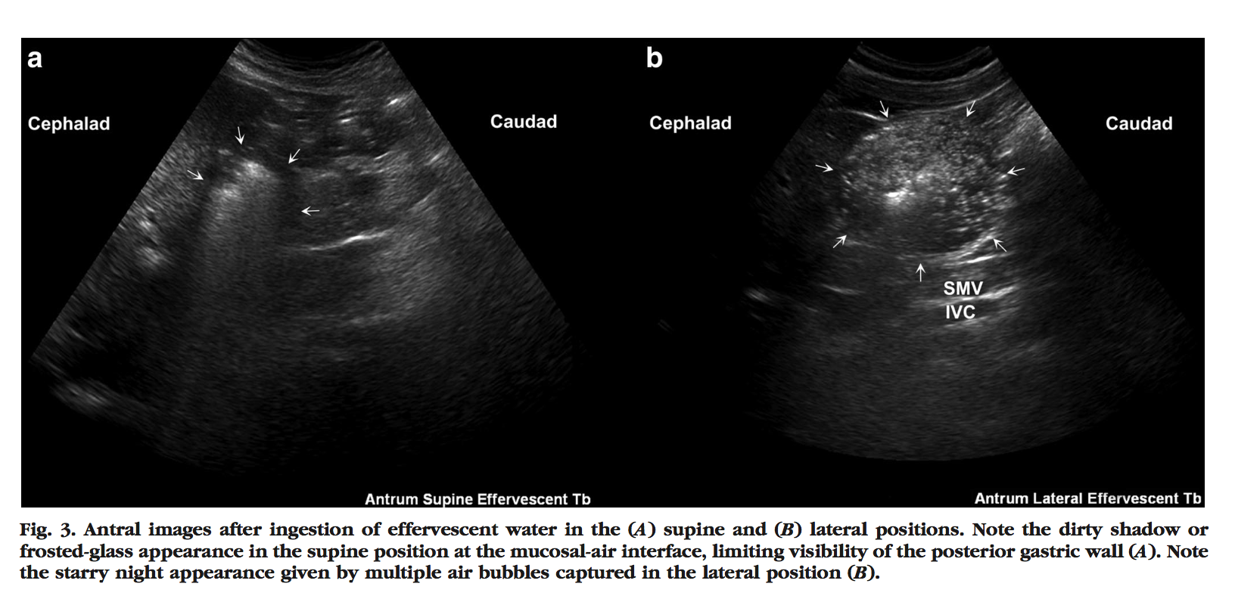
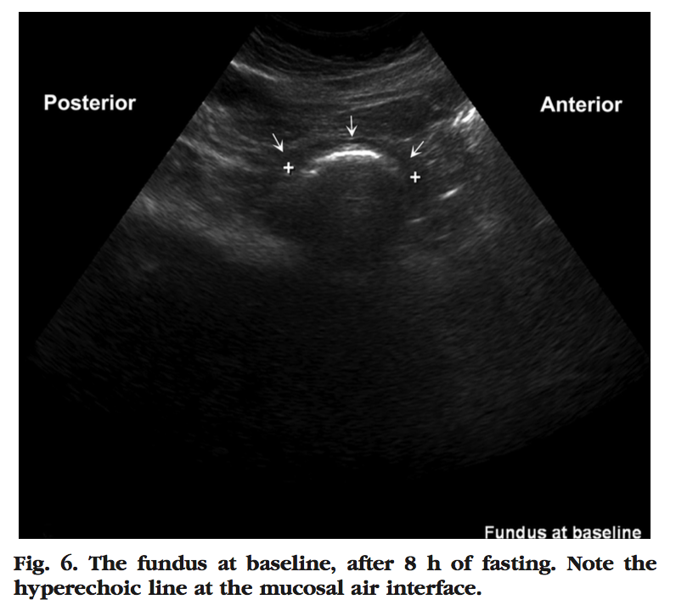
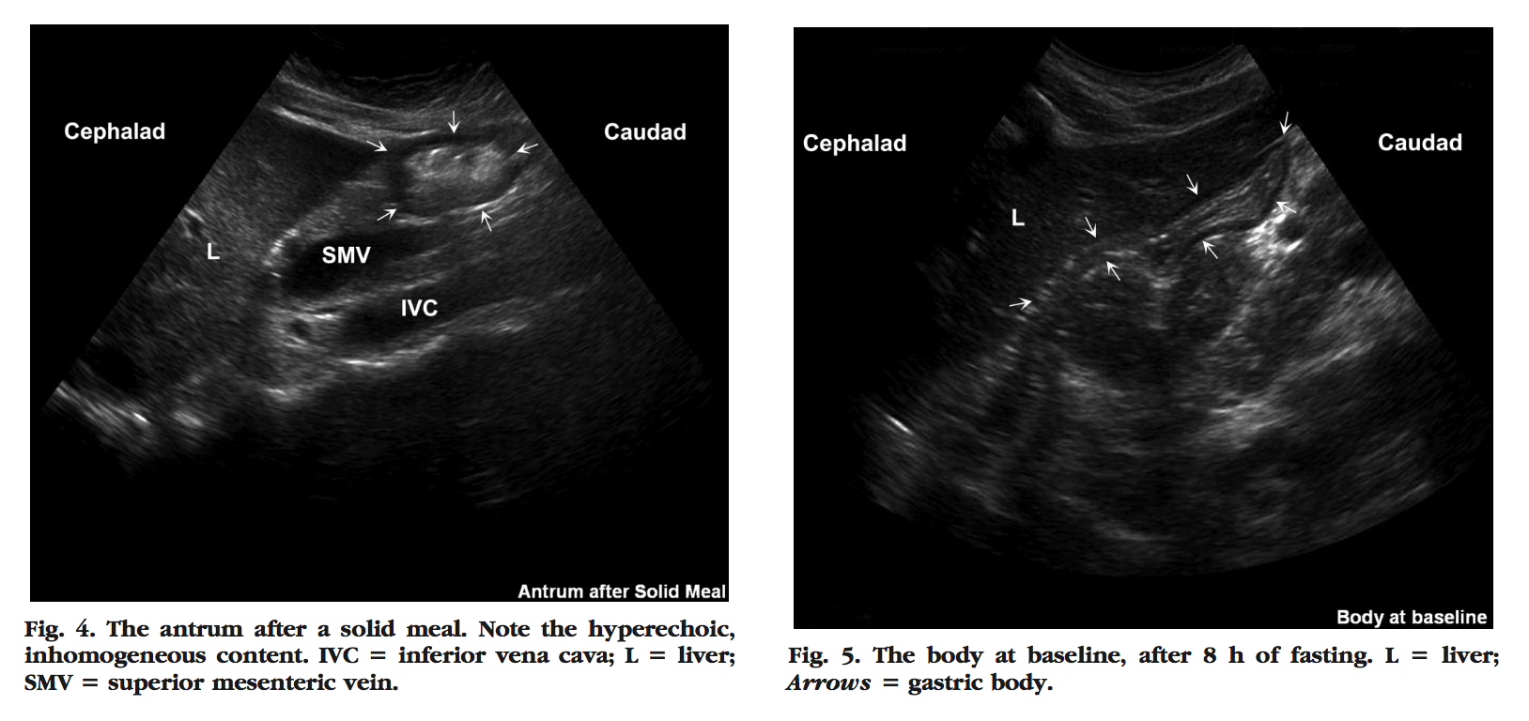

Slide 17
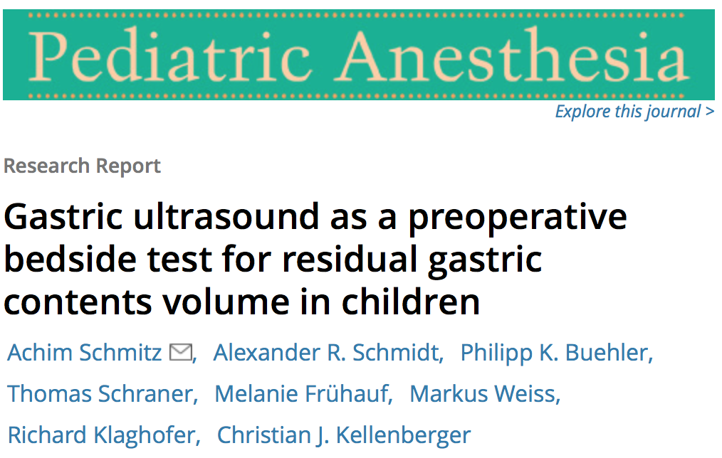

Slide 18
Gastric US
Learning curve very short
No pain/ Not traumatized children
Easy to do in the operating room
RLD or supine position
Tomomasa T, Tabata M, Nako Y, Kaneko H, Morikawa A. Ultrasonographic assessment of intragastric volume in neonates: factors affecting the relationship between intragastric volume and antral cross-sectional area. Pediatr Radiol 1996;26:815-20.
Bouvet L, Chassard D. Apport de l’échographie pour l’évaluation préopératoire du contenu gastrique. Ann Fr Anesth Réanim 2014
Bouvet L, Miquel A, Chassard D, Boselli E, Allaouchiche B, Benhamou D. Could a single standardized ultrasonographic measurement of antral area be of interest for assessing gastric contents? A preliminary report. Eur J Anaesthesiol 2009;26:1015-9.

Slide 19
Emergencies in children

Slide 20
Most frequent…
Acute appendicitis
Trauma
Epistaxis and post-tonsillectomy bleeding
Inguinal hernia and occlusive syndrome
Foreign body in esophagus or trachea
Burns
…

Slide 21
Appendicitis: background
Most commun pediatric surgical emergency
Lifetime risk
8,6% boys / 6,7% girls
Symptoms: dull periumbilical pain that migrates to the RLQ
44% of children present « atypical » symptoms
Ruptured? 80% children <4years and 10-20% of children 10-17 years
Pepper, V et al . Surg Clinics 2012

Slide 22
Appendicectomy
Not so easy to diagnose, 50% = atypical features (!!!! young patients!!!)
Better outcome if early diagnose…..don’t wait
Septic shock/peritonitis
Laparoscopic surgery >>>> laparotomy: reducing requirements for po analgesia,shorter stay in hospital, reduction in minor complications , more rapid return to normal activities ( Wedgewood J et al. Anaesthesia and laparoscopic surgery in children. Ped Anesth,July 2011,vol 11,4,391-399)
« Infiltration of ports sites with LA+ multimodal strategies because pain can be equivalent with laparotomy the first 24h » Ped Anesth. Good pratice in postoperative and procedural pain management , 2012

Slide 23
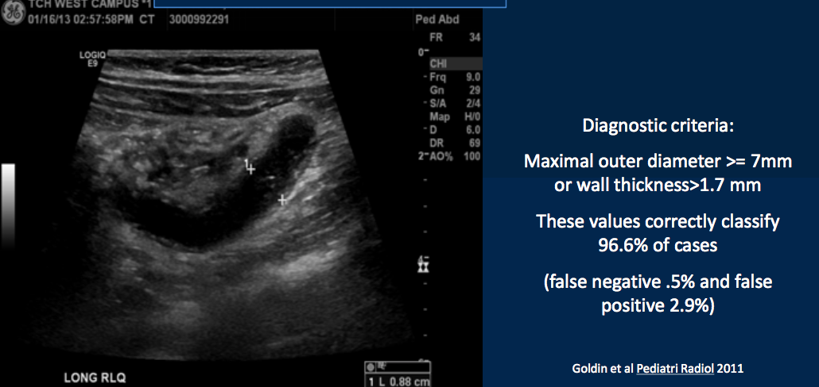
Appendicitis and peritonitis

Slide 24
Appendicitis: Differential Diagnose
Inflammatory
Mesenteric adenitis, IBD, intussusception, omental infarction
Infectious: viral, bacterial or parasitic
Vascular:Congenital
Meckel’s diverticulum, duplication cysts
Genitourinay
Pyelonephritis, PID, ovarian pathology,….

Slide 25
Occlusive syndroms
Previous surgery and adhesions
Hernias
Intussusception
Meckel’s diverticulum
Midgut volvulus
Hirschsprung’s
Tumors

Slide 26
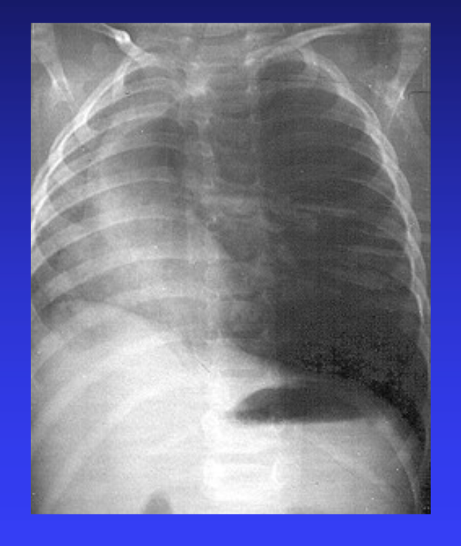
Foreign Body in the respiratory tract
Most common in toddlers, M > F
Presentation
Coughing or choking while eating
Persistent cough or difficulty swallowing
Wheezing or stridor
Examination: locate level of obstruction
Stridor: esophageal FB at cricoid level
Severe obstruction/cyanosis: large FB trapped in glottis or trachea
Unilateral wheezing/air trapping: distal airway aspiration

Slide 27
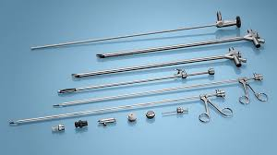
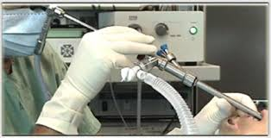
Foreign body
Anesthetic Maintenance
Deep Sevoflurane induction and maintenance, spontaneous ventilation,+/-supplementation with propofol IV
Under deep anesthesia > direct laryngoscopy > supraglottic FB may be removed if visualized
Topical lidocaine spray to airway, max 3 mg/kg
Esophagoscopy needed?
First secure airway with endotracheal tube

Slide 28
Post tonsillectomy bledding
Tonsillectomy and adenoidectomy are the more common surgery in children in many developping countries
Incidence of 0,5%-2%, depending the surgical technique
Primary ( in the first 24h ) or secondary ( to 28days after surgence, peak at 5 days )
Risk increases with age and is higher in male

Slide 29
Anesthetic considerations
Potential hypovolemic shock: preoperative resucitation
Pulmonary aspiration
Potential new difficult intubation ( blood and oedema)
Second GA in few hours, stressfull for everybody

Slide 30
Perioperative assessment
At the theatre soon as possible….bleeding++
IV line
Avoid cardiovascular collapse: fluids given
Transfusion
Rapid sequence intubation (Ketamine/Sux)
Suction
Hb controlled and suction in stomach
Awake extubation

Slide 31
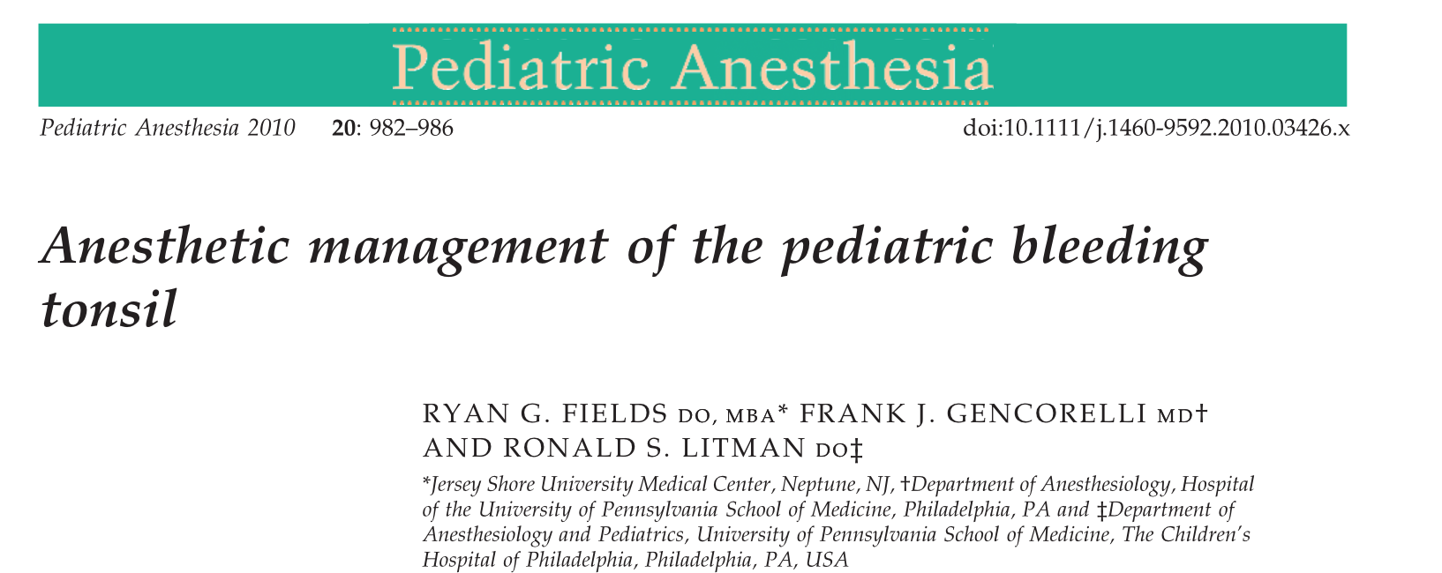
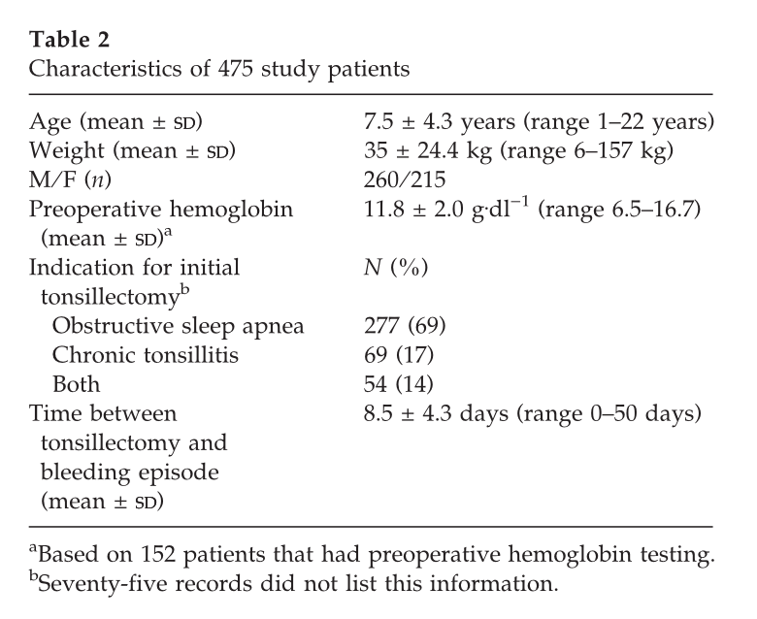
475 children/ 16 596 tonsillectomies
2.9% hemorrhage
IV rapid sequence induction in 84%
Modified RSI in 5.5%
Succinylcholine in 88%/Cricoïd pressure in 90%
Hypoxemia in 9.9% and difficult intubation in 2.7%
Bradycardia in 4.2% and hypotension in 2.5%
Blood loss from 5ml to 500ml
Patients with life-threatening complications
Proper preparation for airway management
and blood volume resucitation

Slide 32
Trauma
Significant challenges to anesthesia provider
Major cause of death (1-14 y)
Motor vehicle collision (59% mortality from all accidents)

Slide 33
Trauma and anesthesiologists
Initial stabilization in the ER
Sedation/Monitoring for imaging
Emergent surgical procedures
Bone fracture fixations
Pain control

Slide 34
Trauma
Temperature monitoring and control
Airway control…full stomach, neck injury…
Warming fluids
Hypotension is a late sign of hemorrhage in children
Tachycardia = First sign
Begin with isotonic crystalloids, 2 boluses of 20ml/kg
Rapid surgical control of bleding
Massive transfusion sometimes needed: RBC/Plama/plattelets 1:1:1 unit ration
Ivashkov Y, Perioperative management of pediatric trauma patientsInt J Crit Illn Sci., 2012, Sept; 2(3):143-148.
Bhalla T,Perioperative management of the pediatric patient with traumatic brain injury, Pediatric Anesthesia, 2012, April;vol 22, 627-640.

Slide 35
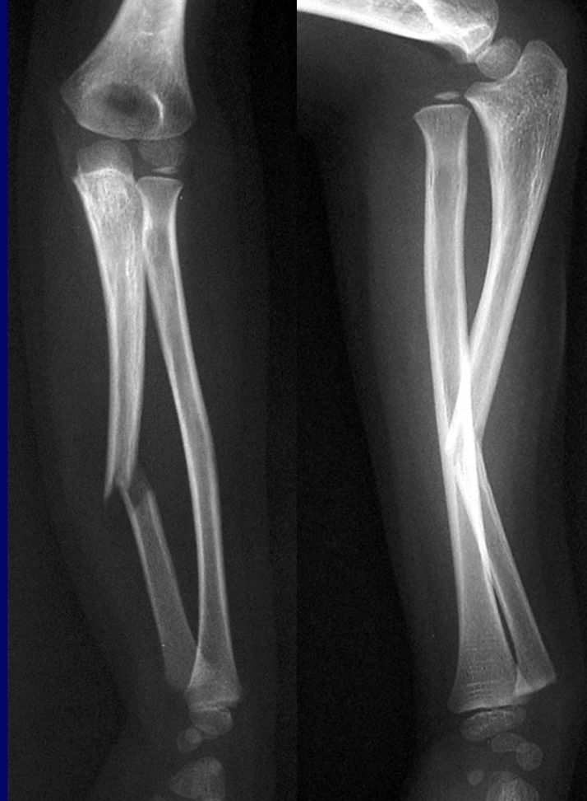
Fractures
Open fractures and nerves/vascular damages = emergency
No fasting needed
Stress/pain for the child Gastric emptying delayed
Local anesthesia possible

Slide 36
Burns
Most physically and psychologically devastating forms of trauma in children
Most common household injury
Children under age of 5, more frequent in male children
70% : hot liquids at home

Slide 37
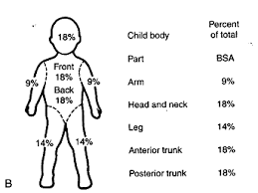
Burns
Barrow et al. Resucitation: « early fluid resucitation »
Rapid cares in burn centers for the critically ill children
Surgery and rapid excision of necrotic skin
Challenging for us: difficult airway, difficult IV access, fluid ans electrolytes imbalances, cardiovascular instability , temperature regulation, increased requirements in opiods and muscle relaxant

Slide 38
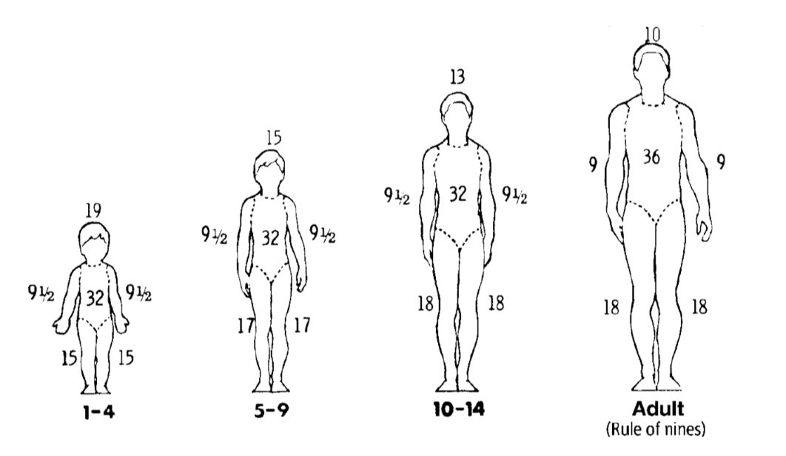
Burns
Severity of injury depends on:
Depth of the burn
Body surface area
location
presence of inhalation
burns in neonates

Slide 39
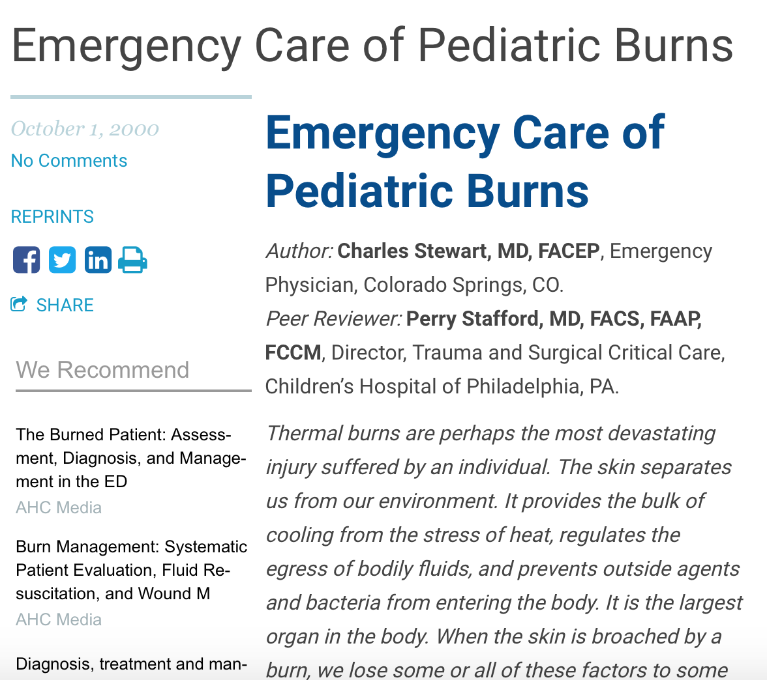
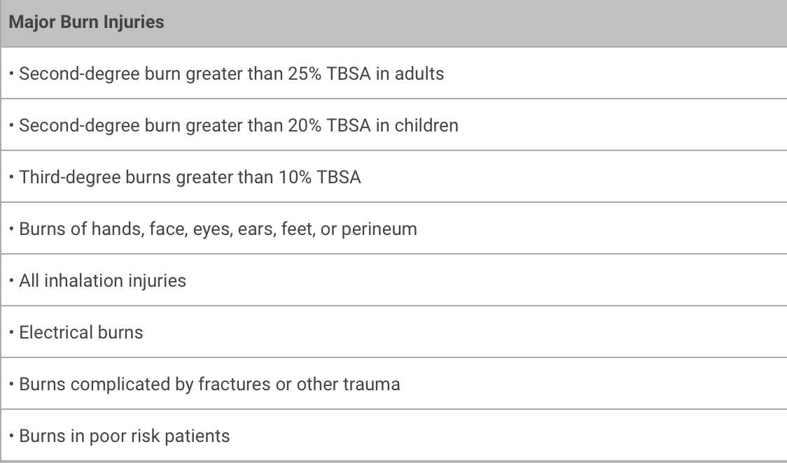
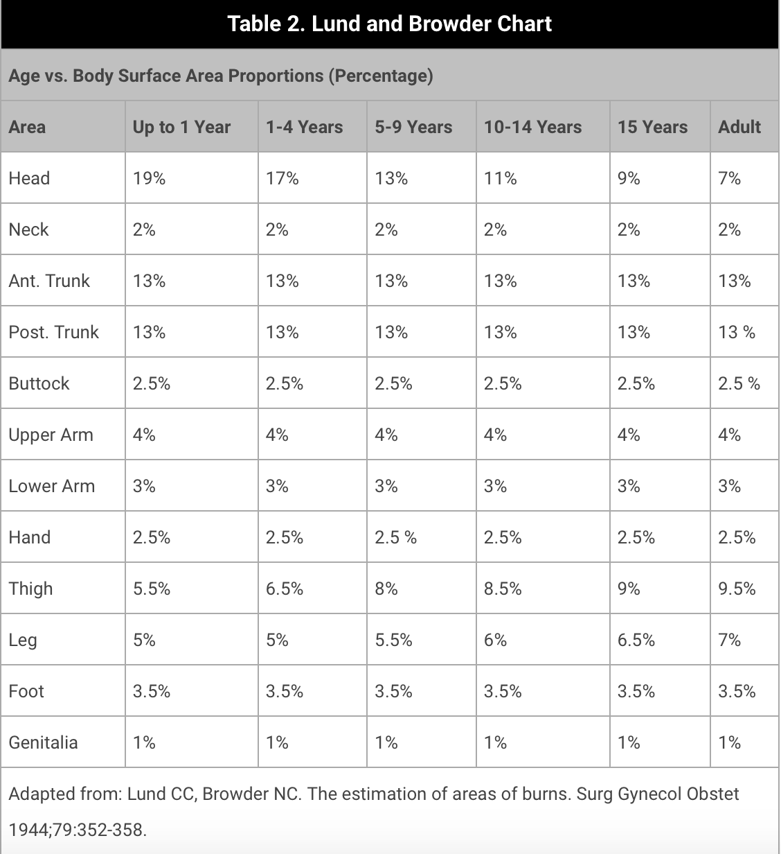
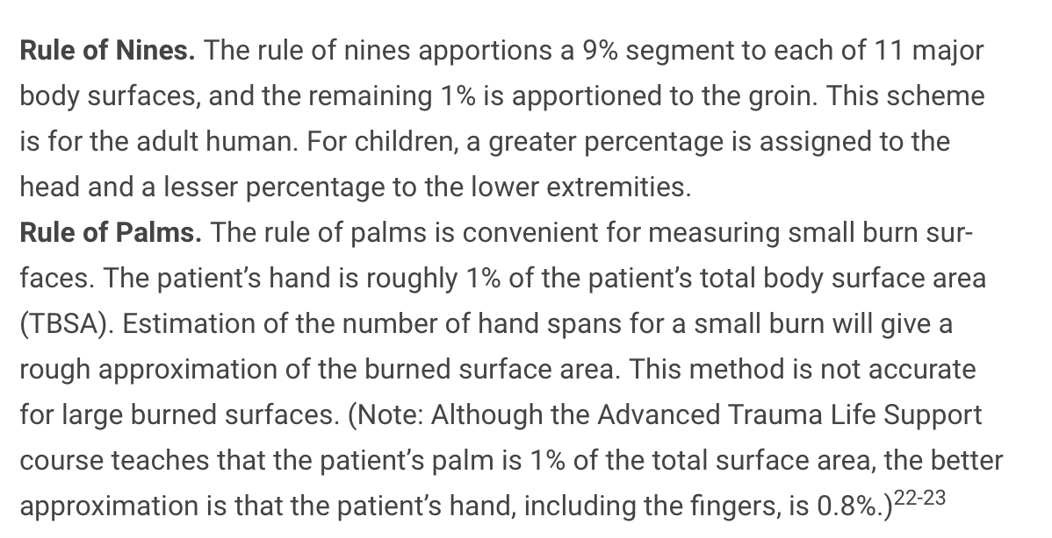
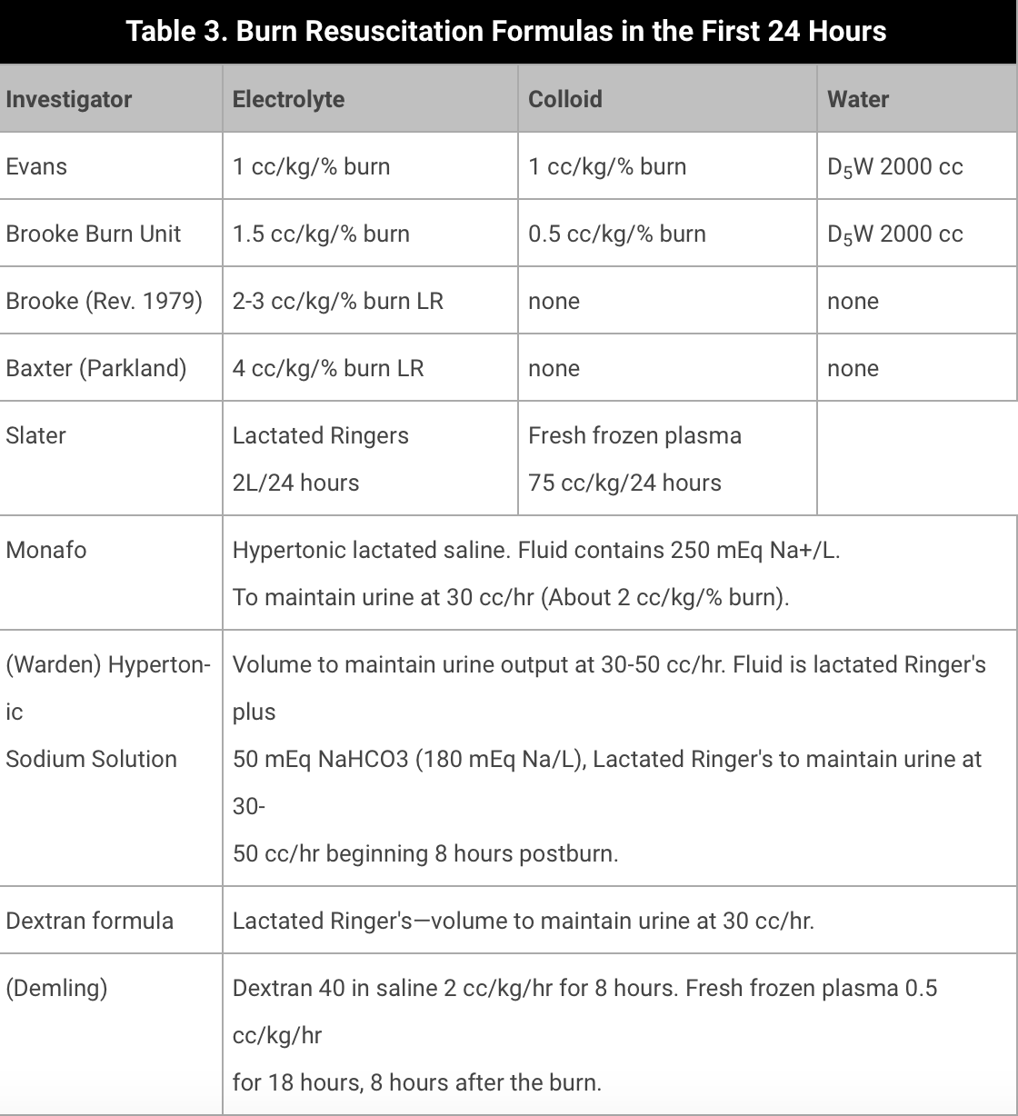
Burns

Slide 40
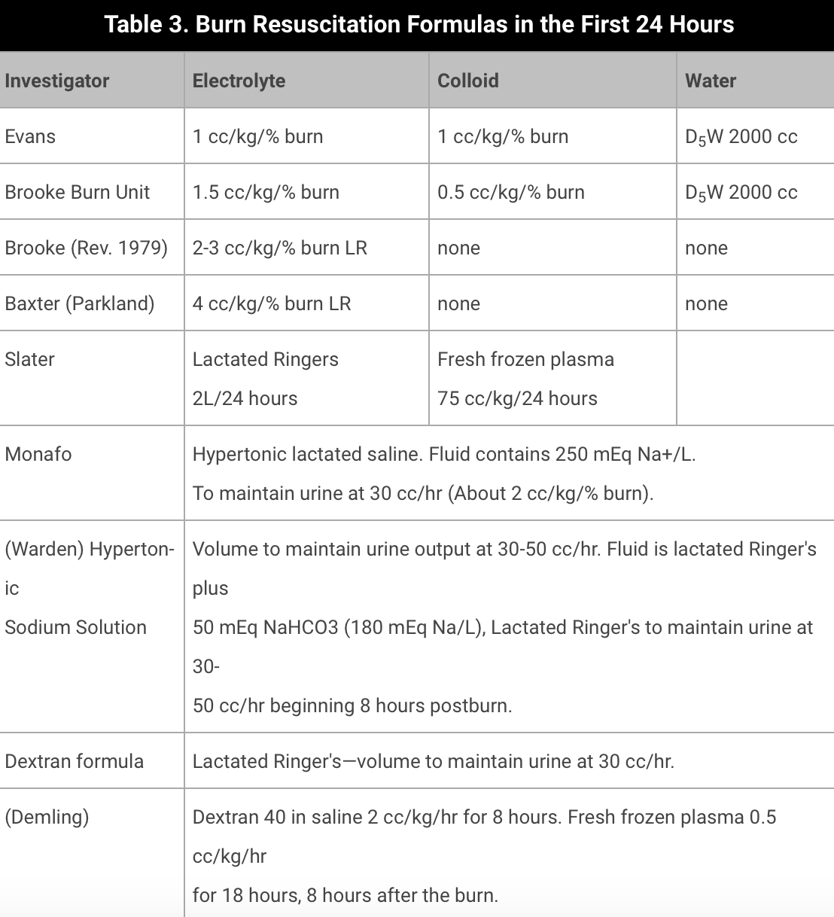
Burns

Slide 41
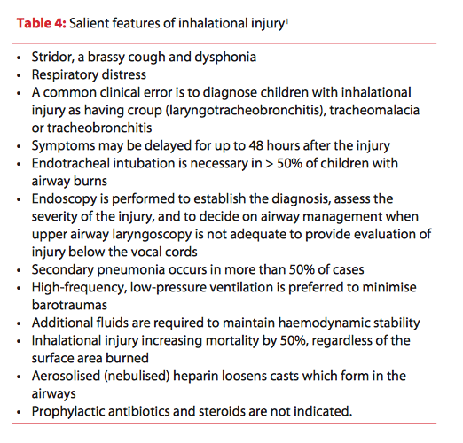
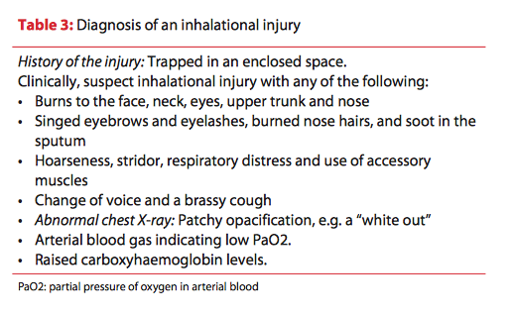
Burns
« Intubate sooner than later »

Slide 42
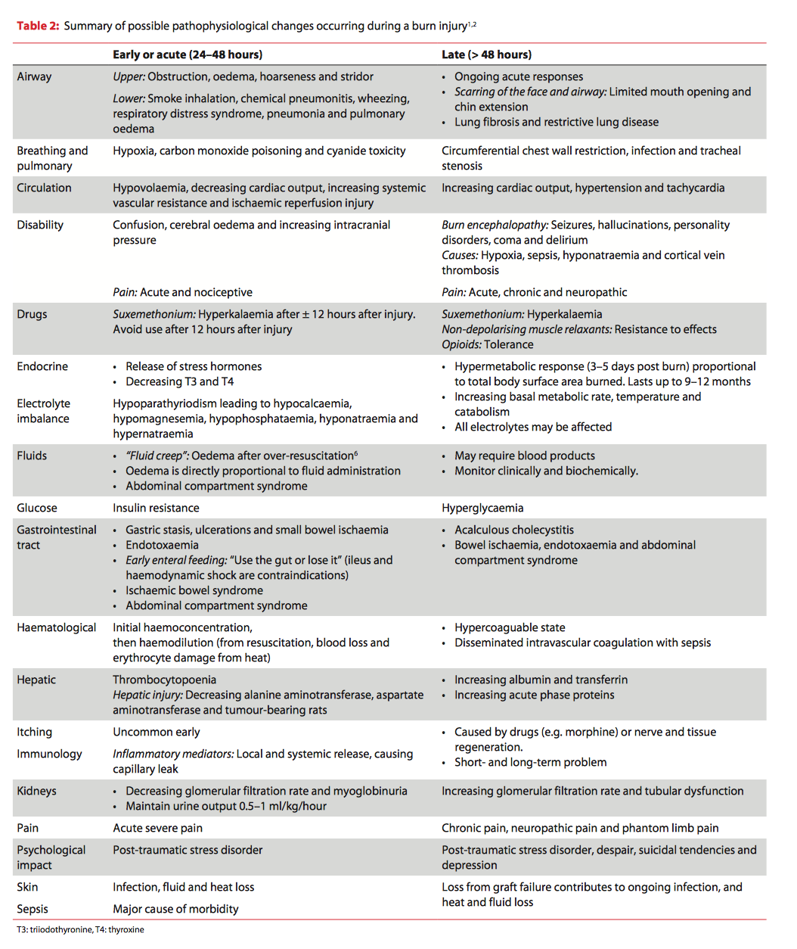

Slide 43
Conclusion
Anesthesia for emergencies carries increased risks
Management for emergencies in children needs some experience et some specific equipment
Cooperation/team with surgeons and others teams in specialist hospitals

Slide 44
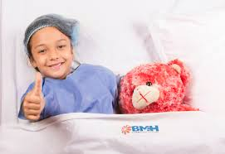
Thank you

