Slide 1
Emergencies in newborns for paediatric anesthesiologists
Jos Bruinenberg, paediatrician-neonatologist
SKA and BAPA congress , March 11th 2017

Slide 2
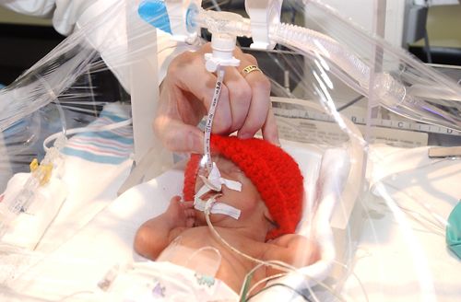

Slide 3
Neonatology
Patient docters
Small people
Microliters
Islander
Protocols
Sometimes acute! They scare the hell out of even experienced clinicians!

Slide 5
Objectives
Important concepts of the guidelines 2015
Selected subjects for anesthesiologists

Slide 6
Content
Quiz!
Guidelines 2015
Catch 22 in neonatal airwaymanagement in general hospitals
ABCDEFGH

Slide 7
QUIZ
Go to https://kahoot.it
Enter the pincode
Choose your player’s name
Earn points for correct answers and reaction time

Slide 8
Guidelines 2015

Slide 9
Ludwig swing, ca. 1920

Slide 10
Mindmap

Slide 11
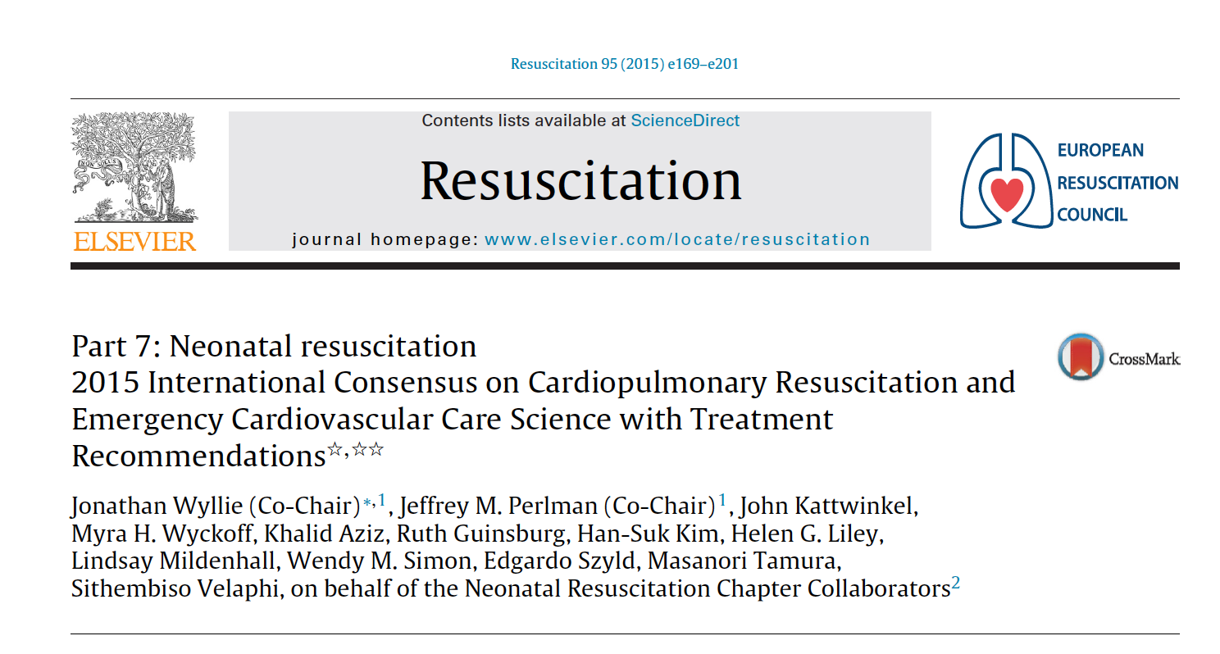
ILCOR

Slide 12
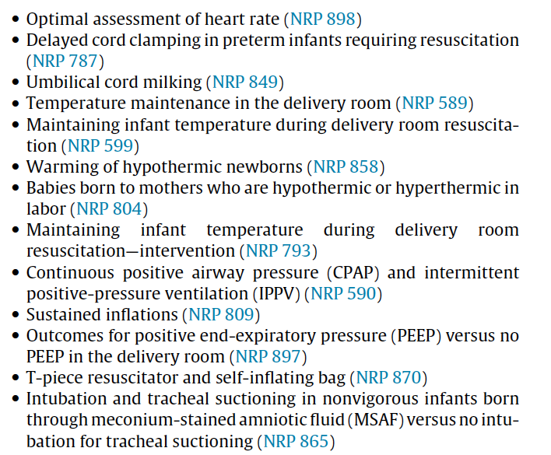
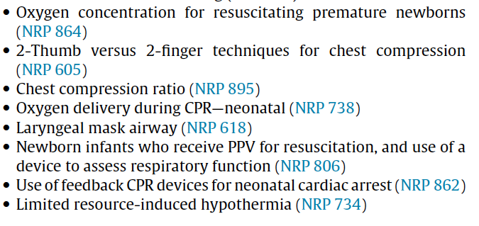
Topics (n=26)

Slide 13
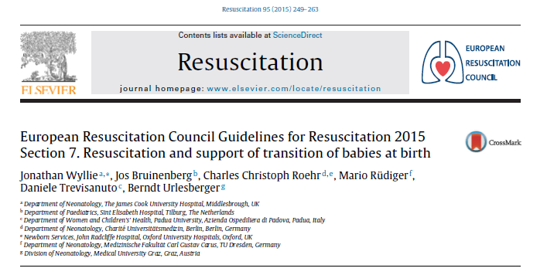

Slide 14
Dutch Resuscitation Council

Slide 15
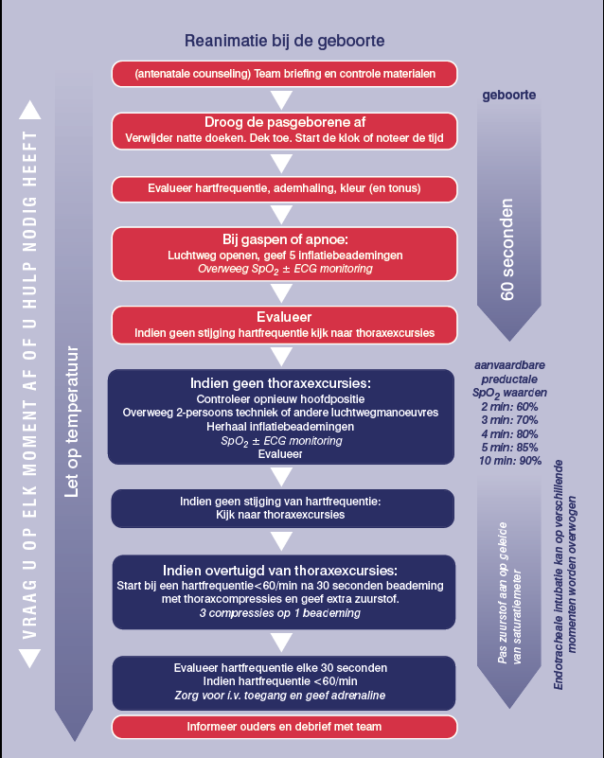

Slide 16
Important concepts
Self resuscitating baby
Assisting in transition
Suction is obsolete
Avoid hypothermia

Slide 17
Breaths
© Northern Neonatal Network
PaO₂
PaCO₂
Excess acid
160
Heart
rate
120
80
40
BP
0
0
10
20
30
40
minutes
Birth
Notes:
This is the final slide in the optional series. If you have used the previous slide you should now reveal how this baby goes on to recover.
As before, if you want to show this slide – “unhide” it using the toolbars → Slideshow → Hide slide

Slide 18
Transition
Cessation of placental circulation; increase in systemic vascular resistance and blood pressure
Initiation of air breathing and marked relaxation of pulmonary vascular resistance
Adaptation of circulation
decrease left-to-right shunt
Closure of the foramen ovale
Thermoregulation increases oxygen consumption

Slide 19
Initiation of breathing air

Slide 20
Adaptations of circulation

Slide 21
Meconium stained amniotic fluid
Routine endotracheal suctioning has been advocated for years!
Always
Only with meconium
Perineal suctioning
Depressed infant with meconium
No evidence found in ILCOR 2015
Emphasis on initiating ventilation

Slide 22
Meconiumaspiration

Slide 24
Maintenance of temperature
Between 36.5-37.5 degrees Celsius
Association with morbidity and mortality
28% increase in mortality per degree!
Association with IVH, respiratory problems, hypoglycemia, late sepsis
Strong predictor
Prognosis
Quality of the clinical process
36 observational studies!

Slide 25
Prevention of hypothermia by a combination of measures
Plastic bag <32 weeks
Heated gas supply
Heating mattress
Environmental temperature
Cap

Slide 26
Intubation

Slide 27
When are you skilled in intubation?
Minimum of 90 intubations for a succespercentage >95%
Minimum of 50 intubations per year for maintenance

Slide 28
Number of intubations by paediatricians

Slide 29
Perceptie vaardigheid

Slide 30
Developments in paediatric anesthesia
Position statement paediatric section of anesthesiologists (children younger than 1 month or 60 weeks conceptional age centralised)
Emerging specialisation in paediatric anesthesia

Slide 31
Premedication

Slide 32
Neonatal airway
small
larynx anterior
large tongue
big occiput
soft epiglottis,
Trachea not straight but diabolo

Slide 34
Catch 22
Pediatricians know neonatal airway but lack ongoing experience
General anesthesiologist intubate a lot, but not infants and young children
Which solutions are available?
Extra education?
Video-assisted intubation
LMA

Slide 36
Laryngeal Mask Airway
Alternative for intubation
>34 weeks, 2000 grams
Failure of bag and mask ventilation
Prolonged ventilation?

Slide 37
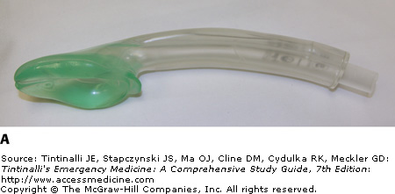
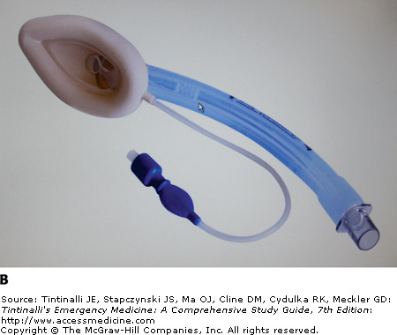
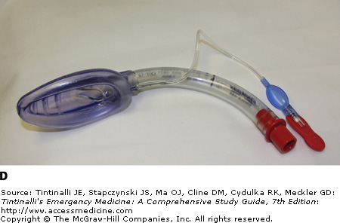
Laryngeal Mask Airway
A prospective evaluation of the efficacy of the laryngeal mask airway during neonatal resuscitation
Xiao-Yu Zhu, Bing-Chun Lin, Qian-Shen Zhang, Hong-Mao Ye and Ren-Jie Yu
Resuscitation
Volume 82, Issue 11, Pages 1405-1409 (November 2011)
DOI: 10.1016/j.resuscitation.2011.06.010

Slide 38
The case of Mohammed
Newborn, 2nd day of life
Decreased consciousness, grayish colour
Sepsis work up
Gas, lactate, glucose normal, LP normal
After 3 hours development of seizures
Transfer to NICU; NH3 2000 mcmol/l>MCAD

Slide 39
Metabolic diseases are rare
Sepsis
Seizures
Hepatic failure
Cardiomyopathy

Slide 40
Catastrophal metabolic diseases
Uric acid cycle defects
Arginin succinate lyase deficiency
Organic acid syndroms
Methylmalonic acidemie
Aminoacidurias
Maple syrup urine disease
Non-ketotische hyperglycinemia

Slide 43
Acute treatment
Stop administration of substrate
Investigate:
Glucose/lactate/bloodgas/NH3
Urine and heparinblood
Consult your paediatrician or metabologist

Slide 44
Questions?

Slide 45
Conclusions quiz
Congratulatios, you are on your way!
(Still, there is a lot to learn out there!)

Slide 46
Conclusions concepts resucitation
Self resuscitating baby>airway!
Take your time to allow recovery and assess
Suctioning should not delay adequate and timely ventilation
Prevent hypothermia

Slide 47
Conclusies Catch 22
Concerning neonatal airwaymanagement: “ Houston, we have a problem”
Which solutions could we provide

Slide 48
Conclusions metabolic diseases
Rare but many
Expression in many vital organs
“ Je ziet het pas als je het door hebt (Cruijff)”
Don’t ever forget glucose and hyperammonia
(ABCDEFGH)

