Slide 1
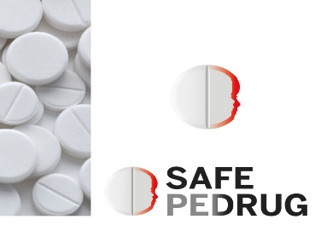


pijnbestrijding bij de zuigeling: wat zijn de opties?
Erasmus MC Rotterdam, the Netherlands
KU Leuven, Belgium
karel allegaert

Slide 2
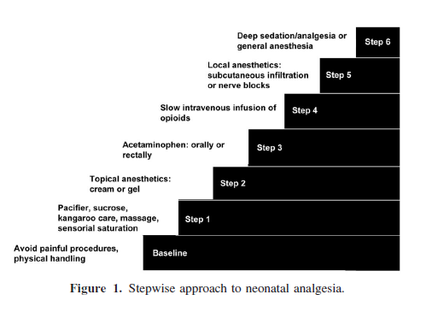

Slide 3

SUGGESTIE 1

Slide 4
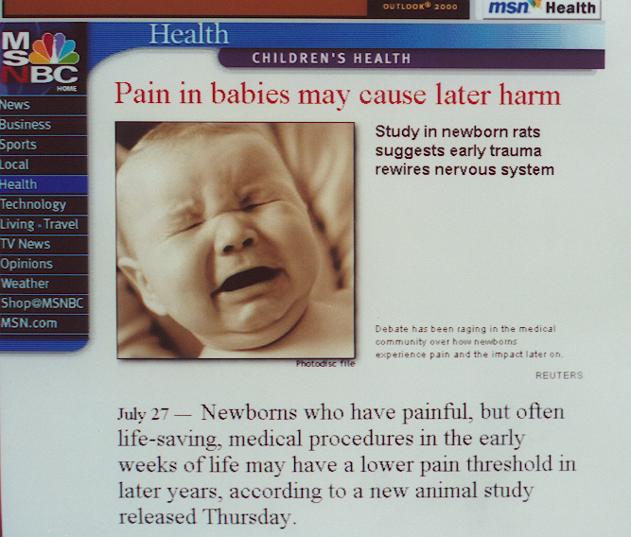

Slide 5
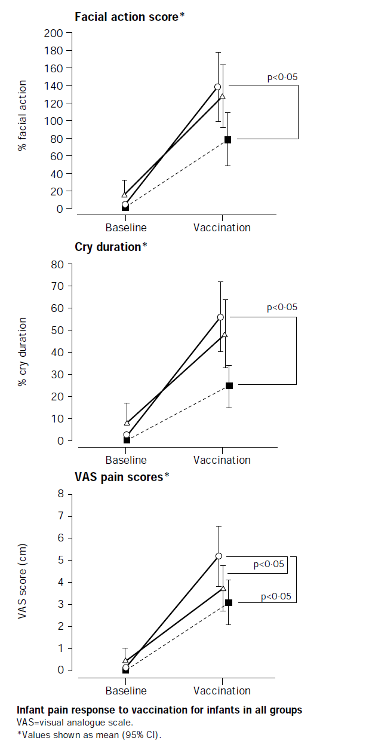
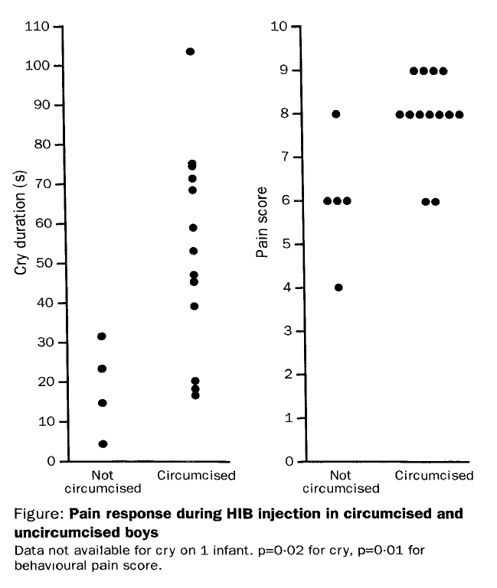
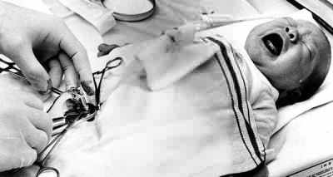
Anand et al. New Engl J Med 1987
Taddio et al. JAMA 2002
Taddio et al. Lancet 1995 and 1997

Slide 6
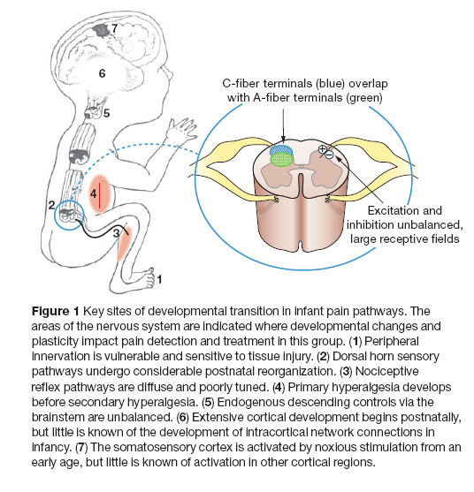
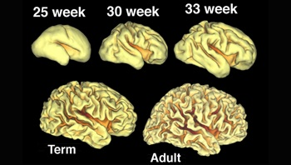

Slide 7
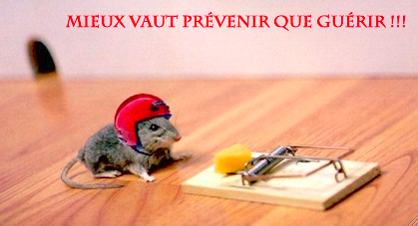
SUGGESTIE 2

Slide 8
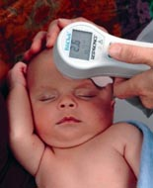

Slide 9
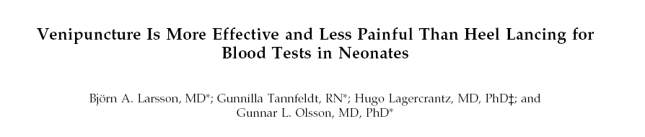
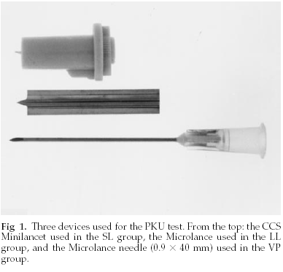

Slide 10
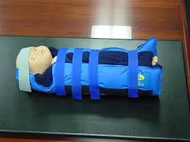
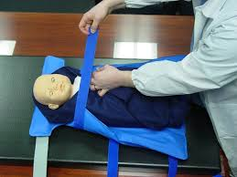

Slide 11
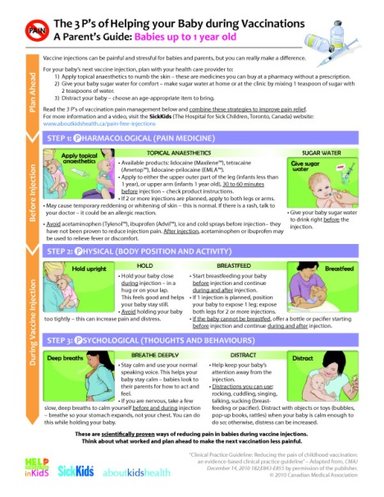

Slide 12
SUGGESTIE 3

Slide 13
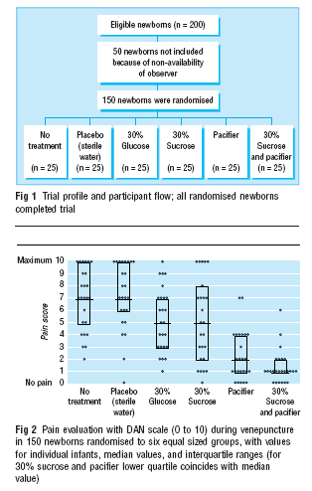
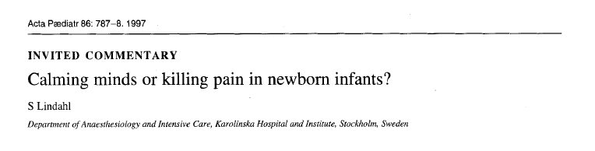

Slide 14
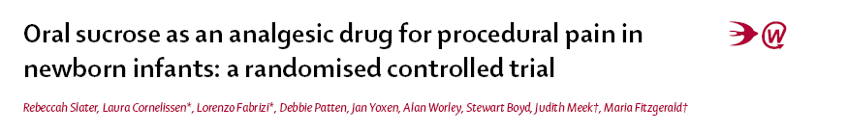
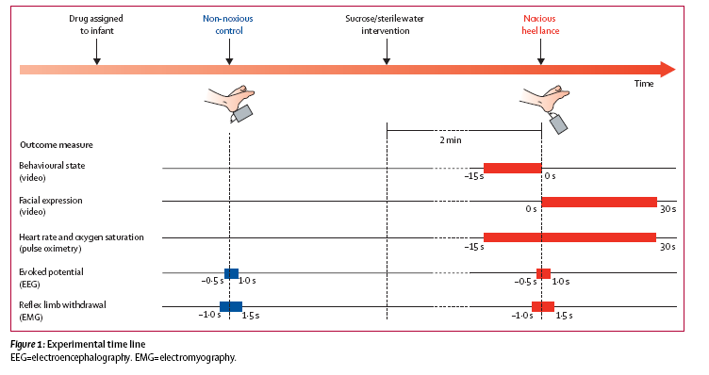

Slide 15
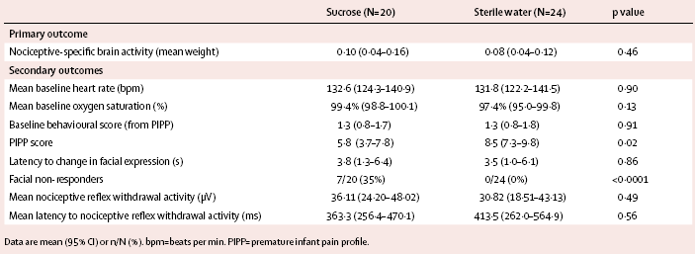

Slide 16
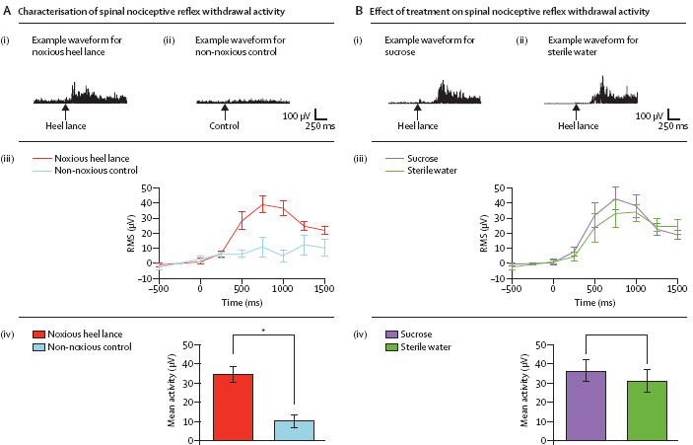

Slide 17
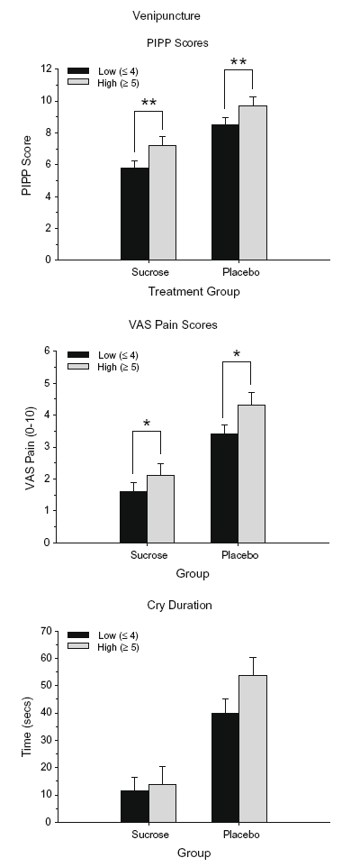
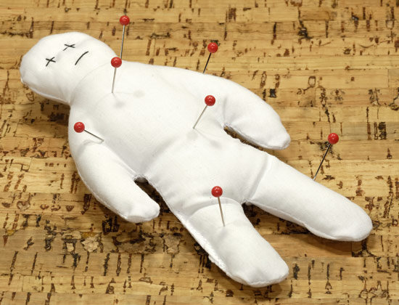

Slide 18
suggestie 4: beperkt effect – if any – in neonates, proven in infants

Slide 20
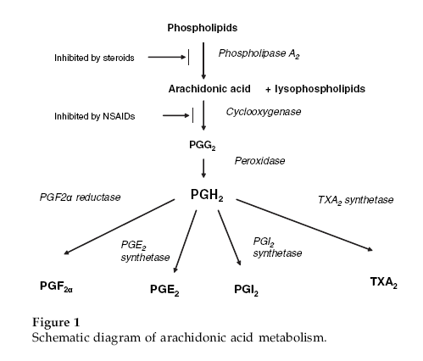
L-arginine-nitric oxide (NO) pathway
Substance P mediated
NMDA (N-methyl D-aspartate)
Serotonergic pain pathways
cannabinoid pathways,
through paracetamol metabolite
(p-amino phenol + arachnidonic acid,
Subsequent cannabinoid receptor activation
(through vanillin receptor – act as ligand)

Slide 21
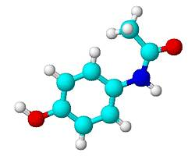
how does paracetamol ‘work’ (pharmacodynamics)
mg/l, plasma
10
antipyretic ? lower
20
> 25
analgesic ceiling or not ?
any type of pain syndrome ?
median conc 10 mg/l

Slide 22
Pacifici, Curr Ther Research 2015

Slide 23
suggestie 4: paracetamol werkt, soms…
standard rectale dosis paracetamol is onvoldoende
lagere bio-availabiliteit
vertraagde absorptie
belangrijke variabiliteit
oral > iv > rectal
denk aan een oplaaddosis: distributie volume
leeftijd gerelateerde veranderingen in klaring zijn eerder beperkt

Slide 24
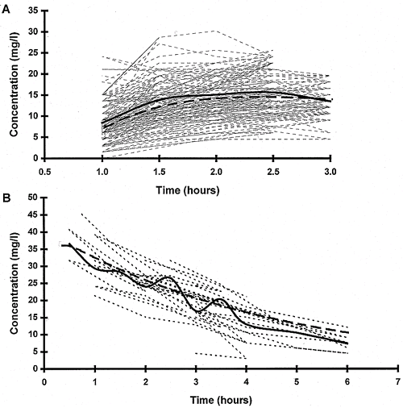
rectaal of oraal, 20 mg/kg single dose na NKO heelkunde
rectal route
oral route
Anderson et al. Anesthesiology 1999

Slide 25
rectaal of oraal, 20 mg/kg single dose na NKO heelkunde
rectal route
Biodisponibility 0.54
oral route
Anderson et al. Anesthesiology 1999

Slide 26
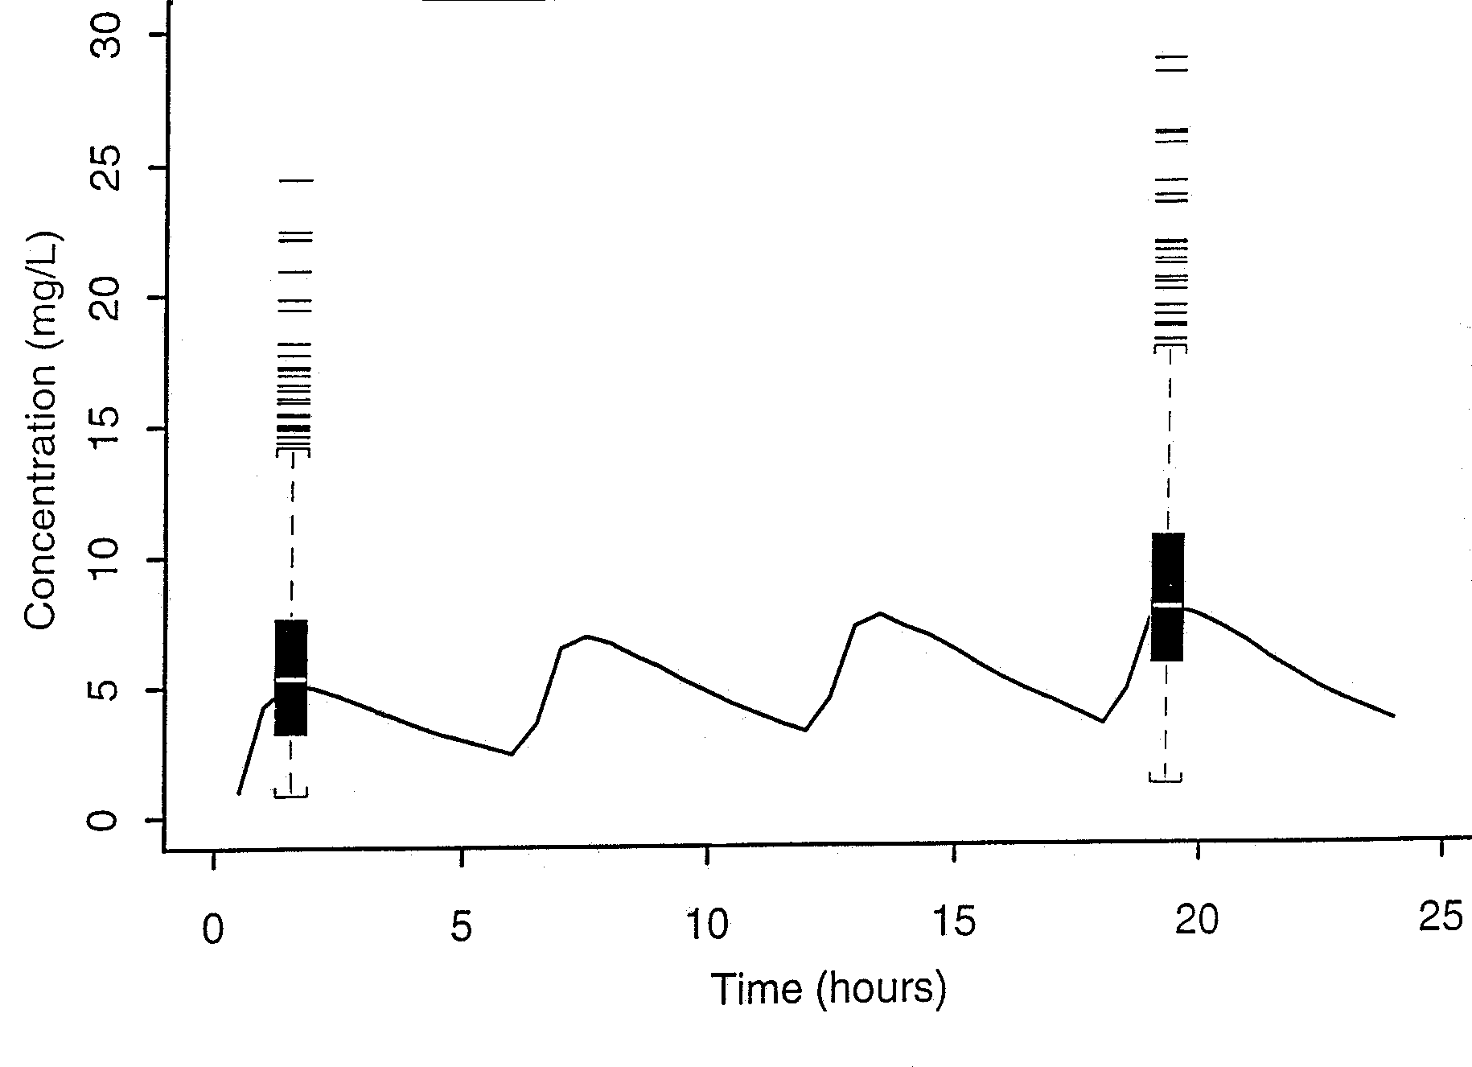
hogere doseringen rectaal ?
Solid box= 50th centile
Values outside the 97.5% centile are shown individually
Anderson et al. Anesthesiology 1999

Slide 27
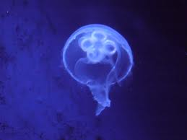
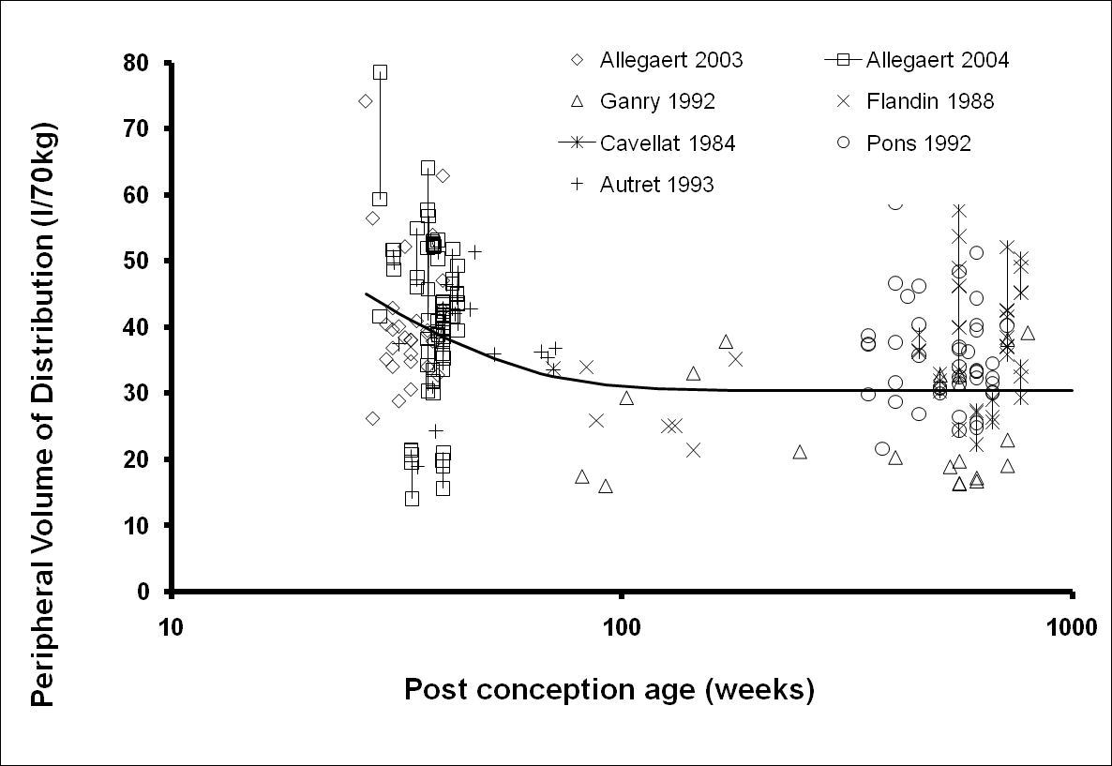
body water/paracetamol distribution
Anderson BJ et al, Paediatr Anaesth 2004

Slide 28
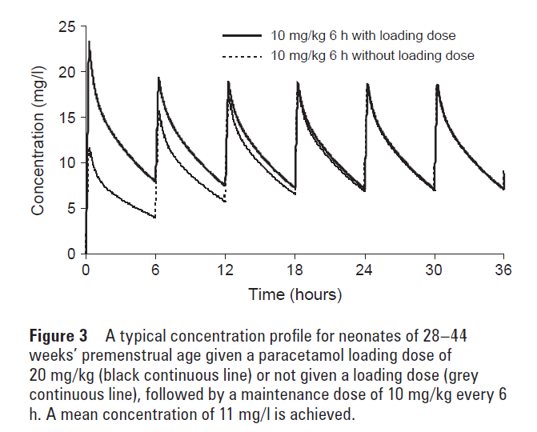

body water/paracetamol distribution
pooled iv paracetamol in neonates. Arch Dis Child 2011

Slide 29
Ceelie et al. JAMA 2013

Slide 30
  Pediatr Anesth, 2014

Slide 31
after procedural pain (heel prick), uniform negative
Reference | Study design and pain model | Paracetamol dosing | Results
Shah et al. Arch Dis Child Fetal Neonatal Ed 1998 | Double blind placebo controlled trial 75 term neonates, heel prick. Facial action pain scores and cry score. | Single oral paracetamol 20 mg/kg or placebo, 60 to 90 min before prick. | No differences in facial action pain scores, nor in cry score.
Bonetto et al. Arch Argent Pediatr 2008 | Prospective randomized trial 76 term neonates, heel prick pain scores (NIPS, neonatal infant pain score>4) | Placebo, dextrose (25%) EMLA or oral paracetamol (20 mg/kg, 60 min) | NIPS<4 similar between placebo, paracetamol or ELMA (47, 42 and 63 %). Oral dextrose most effective (84% NIPS<4, NNT 2.7)
Badiee et al. Saudi Med J 2009 | Randomized placebo controlled trial in 72 preterm (mean 32 weeks) neonates, heel prick PIPP (premature infant pain profile) score | Single (high dose) oral paracetamol (40 mg/kg) 90 minutes before prick. | PIPP scores placebo (9,7, SD 4.2) were similar to paracetamol (11.1, SD 3.8)

Slide 33
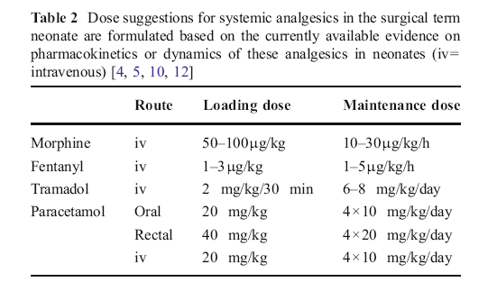

Slide 34
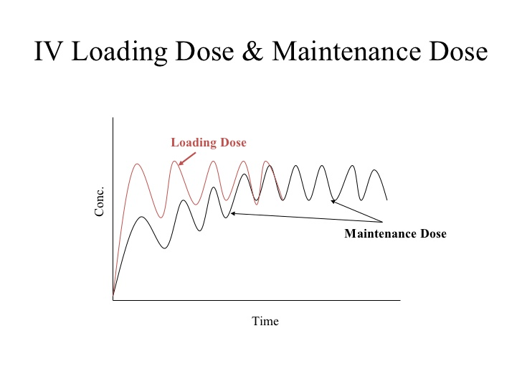
OPLADEN IS VAN BELANG, NOG MEER BIJ PASGEBORENEN

Slide 35

NIKS DOEN IS GEEN OPTIE
PREVENTIEVE MAATREGELEN BESTAAT EN WERKEN
PROCEDURALE PIJNSTILLING
PRO EN CO VAN SUCROSE EN DE VARIANTEN
PRO EN CO VAN TOPISCHE LOCALE ANALGETICA
PARACETAMOL WERKT, SOMS
MILDE PIJNBEELDEN
MORPHINE SPAREND
PROCEDURALE PIJNSTILLING
OPLADEN IS VAN BELANG, NOG MEER BIJ PASGEBORENEN

