Slide 1
Diabetes in childhood
BAPA / SKA refresher course
Jorinde Polderman

Slide 2
Outline
Case
Pumps and Sensors
Perioperative recommendations
Take home messages

Slide 3
Case
14-month old girl presents with
  Fuzziness
  Nasal congestion
  tachypnea
  non-bilious emesis
  Making wet dipers
  Otherwise healthy, well fed, fully immunized
Roberts et al. MedEd Portal 2021

Slide 4
Case
Vital signs: Well developed, well nourished fussy female toddler with mild respiratory distress and tachypnea held by a parent.
Temp 36.8, HR 160, RR 31, BP 100/53, Sats 100%
Lab: pH 7.11, pCO2 15, pO2 80, bicarbonate 4.9, base excess -24.7
Electrolytes: Sodium 132 potassium 5.2, ionized calcium 1.44, Lactate 1.8, Glucose 25 mmol/l
Urinalysis: large ketones, 3+ glucose
BUN 20, creatinine 0.6
14-month old girl
  Fuzziness
  Nasal congestion
  tachypnea
  non-bilious emesis
  Making wet dipers
  Otherwise healthy, well fed, fully immunized
Roberts et al. MedEd Portal 2021

Slide 5
Diabetic ketoacidosis
First time DKA can be difficult to diagnose
Maintain high degree of suspicion with:
  Abdominal pain
  Vomiting
  Fatigue
  Headache
  Polyuria/polydipsia
  Known family history of diabetes
  High risk group: toddler, teen, insulin pump
Glaser et al. ISPAD Guidelines 2022
Notes:
Particularly hard to diagnose in patients younger than 5 years old

Slide 6
DKA Diagnostic Criteria
Hyperglycemia
Glucose > 200 mg/dL
Ketosis
Urine or serum ketones
Acidosis
Venous pH < 7.30 or serum bicarbonate < 18 mmol/L
Glaser et al. ISPAD Guidelines 2022
Notes:
Serum ketones more closely correlate to clinical state but not immediately available in all settings
The biochemical criteria for the diagnosis of DKA are:
Hyperglycemia (blood glucose >200 mg/dL)
Acidosis (venous pH<7.3 or serum bicarbonate level <15mmol/L)
Ketonemia (serum b-hydroxybutyrate (BOHB) ≥ 3mmol/L or ketonuria ( ≥ 2+, moderate or large)

Slide 7
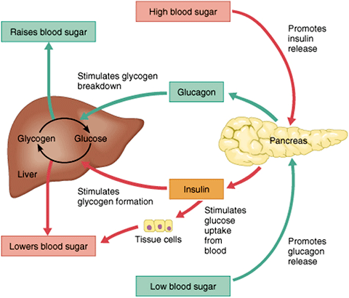
Normal glucose regulation

Slide 8
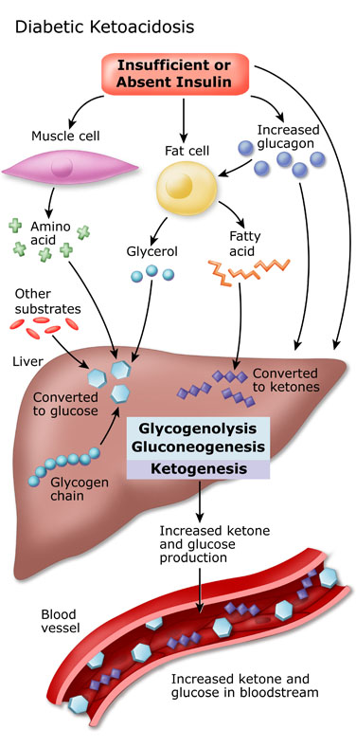
DKA pathofysiology
Notes:
Het glucose in je bloed kan niet gebruikt worden → blijft stijgen in bloed
Cellen schakelen over op eiwit- en vetverbranding
Opstapeling van AcetylCoA’s → ketonen
Ketonen stapelen zich op → verzuring

Slide 9
Treatment of DKA
Initial fluid bolus 10-20 ml/kg over 30 minutes
  Risk of cerebral edema
Assume total body potassium deficit
No sodiumbicarbonate infusion
Insulin therapy 1 hr after IV fluid
Slow volume deficit correction over 24-48 hours
Glaser et al. ISPAD Guidelines 2022

Slide 10
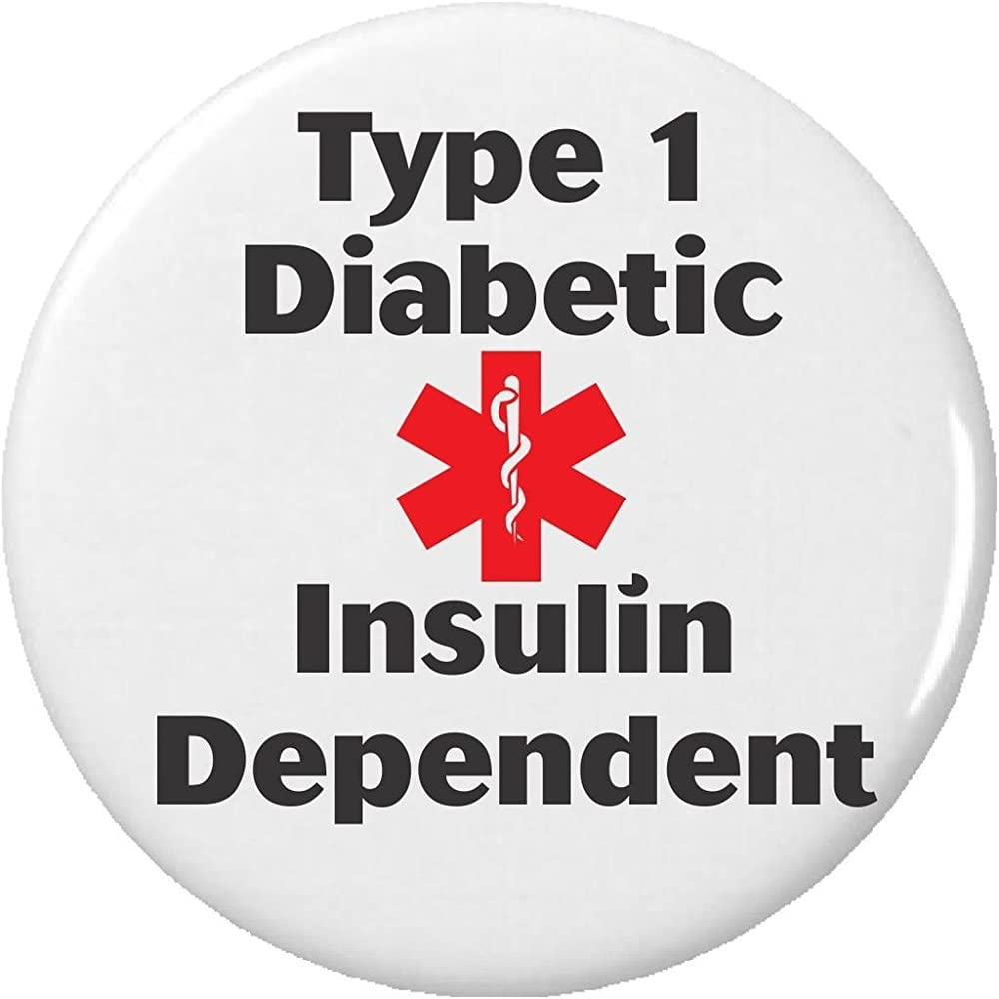
Type 1 Diabetes
9000 children in the Netherlands with known diabetes
15-20% in children aged < 5 years old
Around 90% of the children with diabetes has DM1
Auto-immune destruction of beta cells
Always require exogenous insulin
Siller et al. Pediatr Diabetes 2021
Mentink et al. Pediatr Diabetes 2020
Notes:
In NL ongeveer 9000 kinderen met DM
Most autoimmune diseases female > male
Incidence of female cases is equal to male cases
Peak onset is in early to mid-puberty

Slide 11
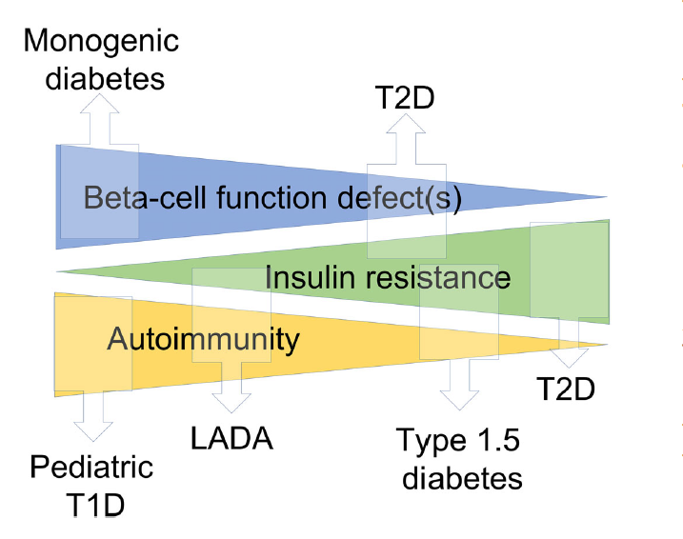
Other types of Diabetes
Siller et al. Pediatr Diabetes 2020
Notes:
20.000 children with DM2 in USA
Incidence is rapidly increasing

Slide 12
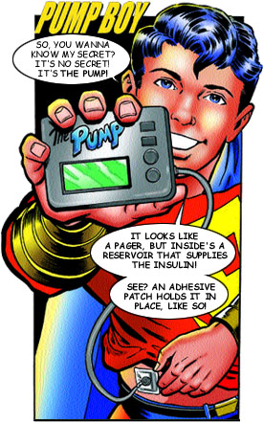
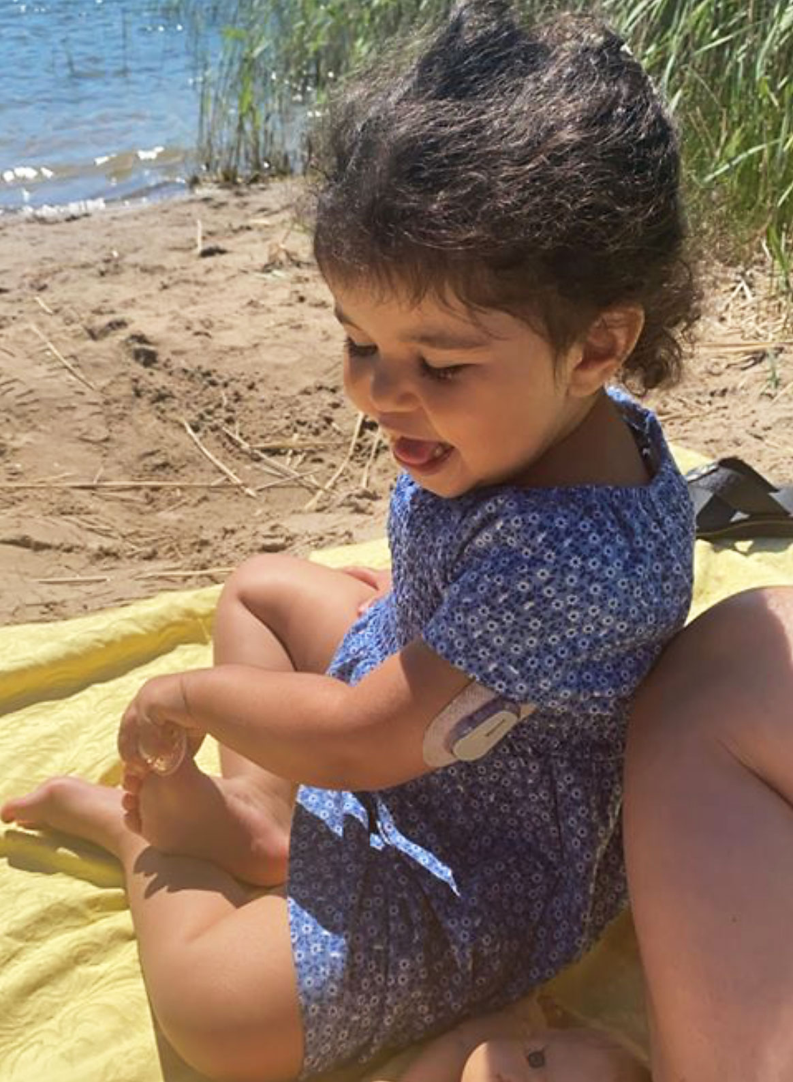
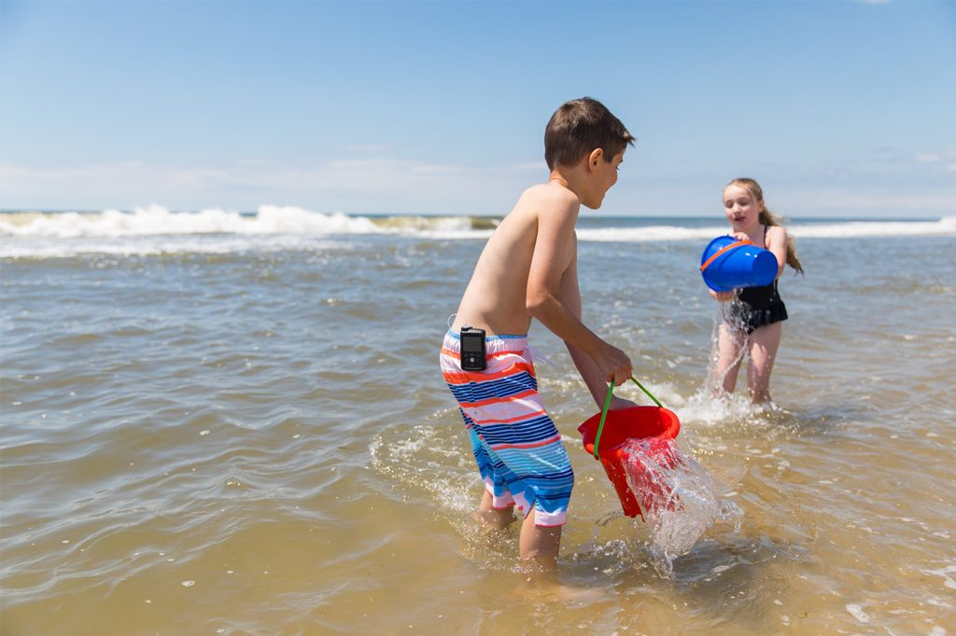
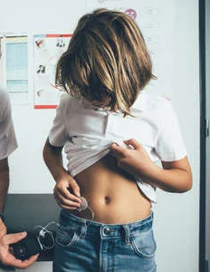
Subcutaneous Insulin Pumps
Notes:
Almost 70% of the children is managed with an insulin pump

Slide 13
Preoperative planning
Take adequate history
Involve own endocrinologist
Schedule als first case of the day
Discuss treatment plan with patient and family
  Use of own insulin pump or not
  Adjustments of insulin dosing
  Escape for hypo- and hyperglycaemia
ISPAD consensus guideline Jefferies et al. Ped Diab 2018
Vanderhoek et al. Ped Anest 2019
Martin et al. A&A 2020

Slide 14
Intraoperative management
Measure POCT glucose every hour during procedure
When using insulin pump
  Make sure infusion set is accessible during procedure and know how to use it
  Shield with lead for radiation
  Bipolar electrocautery whenever possible
  If monopolar cautery is needed, make sure current pathway does not pass through pump
ISPAD consensus guideline Jefferies et al. Ped Diab 2018
Vanderhoek et al. Ped Anest 2019
Martin et al. A&A 2020

Slide 15
Postoperative care
Hourly glucose checks
May be discharged when:
  Able to eat and drink
  PONV –
  Resume usual diabetes treatment schedule
  More frequent glucose checks recommended in first 24-48hrs
ISPAD consensus guideline Jefferies et al. Ped Diab 2018
Vanderhoek et al. Ped Anest 2019
Martin et al. A&A 2020

Slide 16
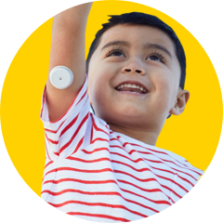
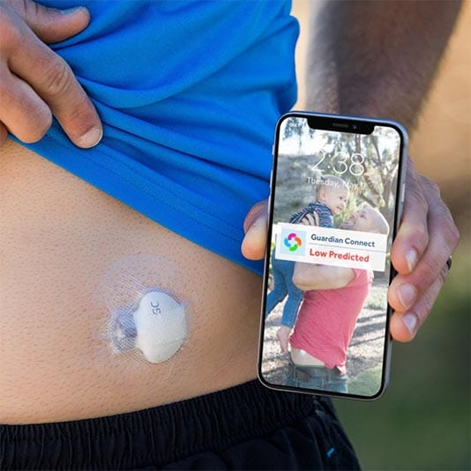
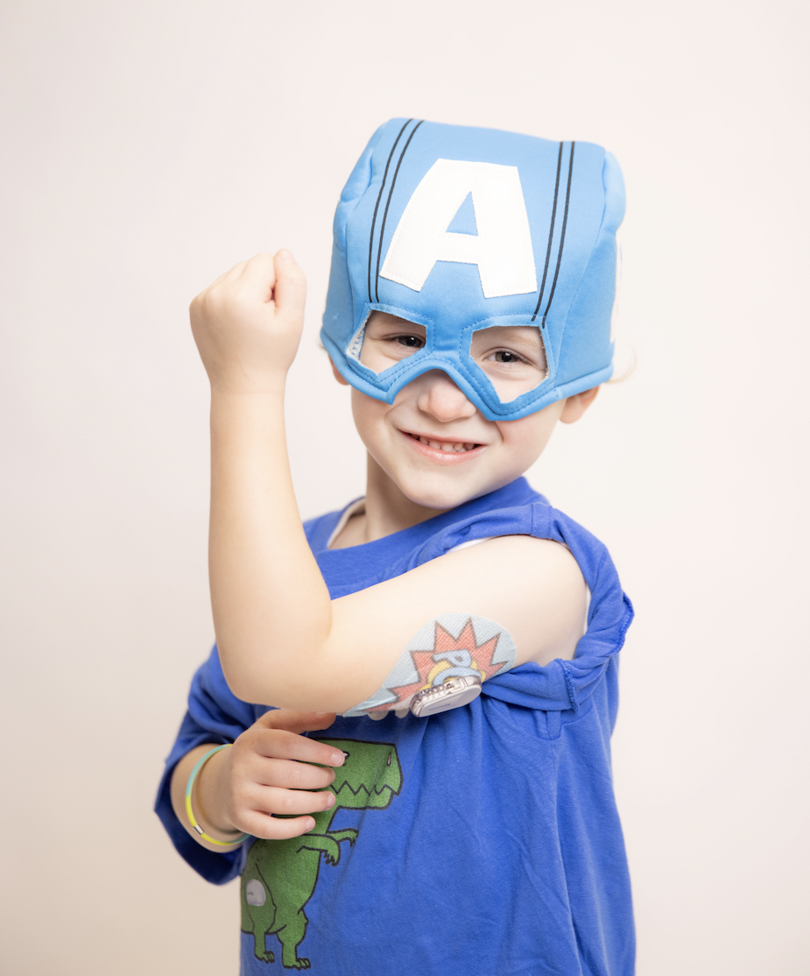
Glucose Sensors
Freestyle Libre
Guardian Connect
Dexcom

Slide 17
Target range
Keep glucose between 5 – 10 mmol/l
Check for ketones if glucose is > 15 mmol/l
Use child’s own correction factor to treat hyperglycaemia
  Correction Factor (CF) or Insulin Sensitivity Factor (ISF): The expected decrease in blood glucose (BG) after administering 1 unit of insulin
Use sensors with caution, preferebly under prospective research protocols and with additional POCT glucose checks
ISPAD consensus guideline Jefferies et al. Ped Diab 2018
Vanderhoek et al. Ped Anest 2019
Martin et al. A&A 2020

Slide 18
Dexamethasone
58 paediatric patients with DM1
Hyperglycaemica occured in 78% of the patients
10 patients received dexamethasone, blood glucose decreased 0.1 mmol/l compared to -0.7 mmol/l in those who did not receive dexamethasone (n=48)
Caray et al. Unpublished data

Slide 19
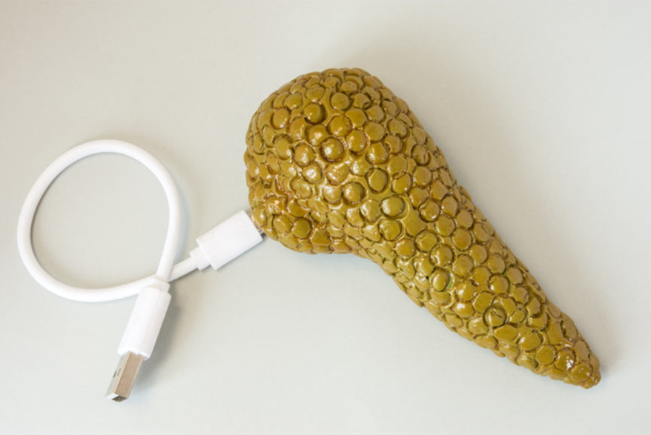
The ideal world

Slide 20
Hybrid closed loop during surgery
Dominguez-Riscart, Frontiers in pediatrics 2021

Slide 21


Take home
Be aware of insulin pumps and glucose sensors
Consult own endocrinologist for perioperative plan
When in doubt, take it out and start IV insulin
Keep checking glucose

Slide 22
Types of insulin

