Slide 1
The mystery of coagulation (defects) and why children are not little adults
Prof. Dr. Veerle Labarque
Pediatric Hemato-Oncology UZ Leuven
BAPA Refresher Course 2023
21 January 2023

Slide 2
Overview
basis of clot formation
recognizing a patient with a bleeding disorder
congenital bleeding disorders
treatment options
Notes:
Why children are not little adults:
In adults both congenital and acquired (eg. Medication) but less common medication in children

Slide 3
How is a clot made?

Slide 4
Adhesion: collagen and Von Willebrand Factor

Slide 5
TxA₂ formation
Secretion
ATP
Activation
Notes:
TxA2 vorming ~ verhinderd door aspirine

Slide 6
TxA₂ formation
Expression procoagulant surface (PS*)
Secretion
ATP
* phosphatidylserine
Aggregation - 1° hemostasis

Slide 7
fibrin
2° hemostasis

Slide 8
How is a clot made?
Hemostasis = 4 important steps
1° hemostasis: local vasoconstriction & formation of platelet-plug
2° hemostasis: coagulation cascade (fibrin clot)
inhibition of coagulation (natural anticoagulants)
fibrinolysis

Slide 9
Important questions
Does the patient have a bleeding disorder?
What should I do in case of surgery? Invasive procedures?

Slide 10
Known inherited bleeding disorder
no invasive procedure without contacting treating hematologist !
peri-operative plan should be prepared by treating hematologist !

Slide 11
No known inherited bleeding disorder: initial evaluation
age and gender
bleeding symptoms (bleeding score)
personal history (tonsillectomy? circumcision?)
familial history (cave hereditary disorders)
physical examination: bruising, petechiae,…

Slide 12
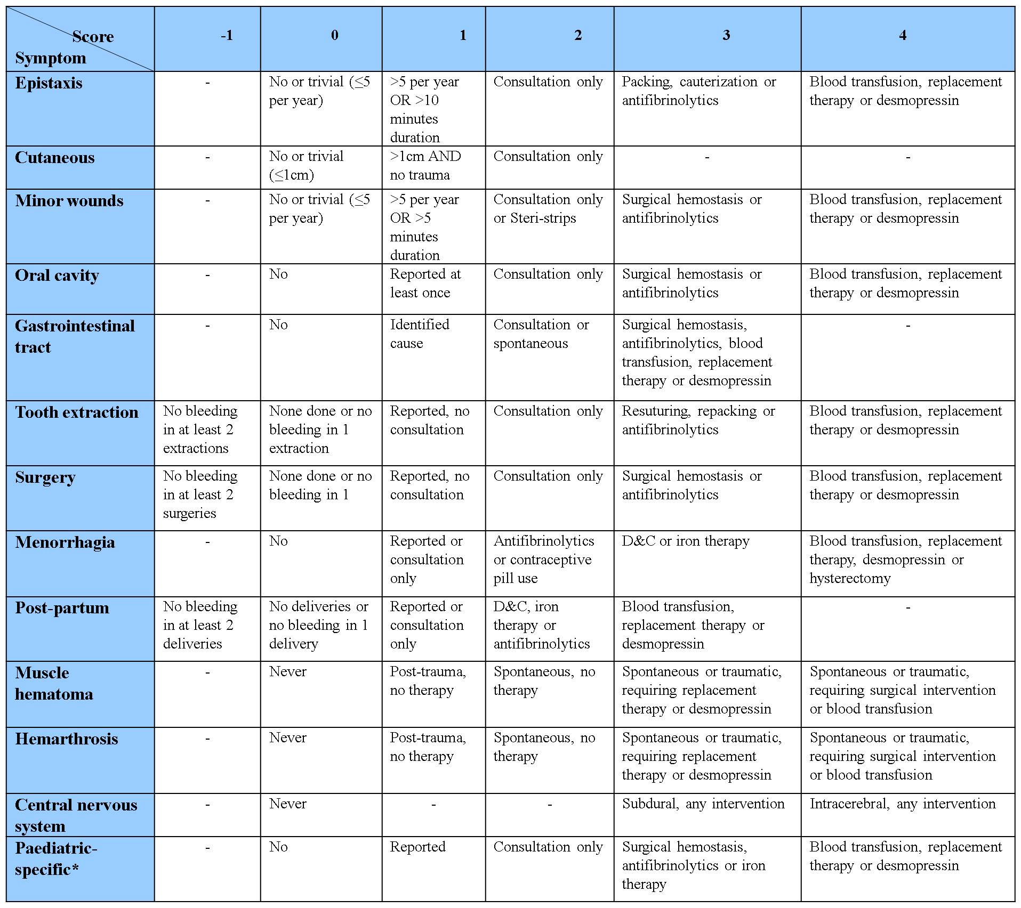
Bowman et al. JTH 2009

Slide 13
Pediatric-specific bleeding symptoms
post-circumcision bleeding
cephalohematoma
macroscopic hematuria
bleeding from the umbilical stump
conjunctival hemorrhage
post-venepuncture bleeding
Bowman et al. JTH 2009

Slide 14
Laboratory evaluation
no routine pre-operative coagulation screening (INR/aPTT) in unselected patients
thorough history taking is indispensable!

Slide 15
Laboratory evaluation
CAVE may be normal in mild disorders or platelet dysfunction → refer to (pediatric) hematologist
CAVE young children (more difficult history; developmental hemostasis)

Slide 16
Developmental hemostasis
INR/aPTT “prolonged” in neonates/young infants

Slide 17
von Willebrand disease
thrombocytopenia
coagulation disorder
platelet dysfunction

Slide 18
Bleeding pattern
 | PRIMARY hemostasis | SECONDARY hemostasis
 | platelets von Willebrand (mild) | coagulation factors von Willebrand (severe)
petechiae | + | -
hematoma | + | indurated
surgical bleeding | immediate | delayed
joint bleeds | - | +
bleeding from wounds | stops with pressure (15min) | Always restarts

Slide 19
von Willebrand disease
Type | Characteristics
Type 1 | partial quantitative deficiency | AD
Type 2 | qualitative deficiency - 2A: impaired interaction with platelets - 2M: impaired interaction with platelets - 2B: enhanced interaction with platelets - 2N: impaired interaction with FVIII | AD (AR)
Type 3 | absence | AR

Slide 20
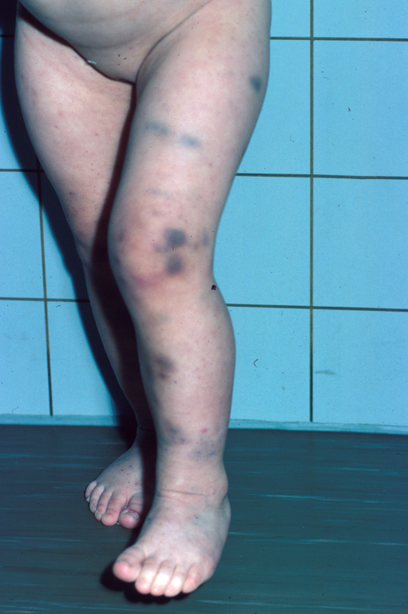
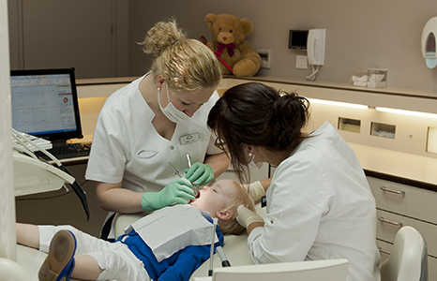
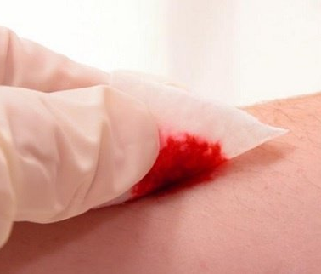
von Willebrand disease (all)

Slide 21
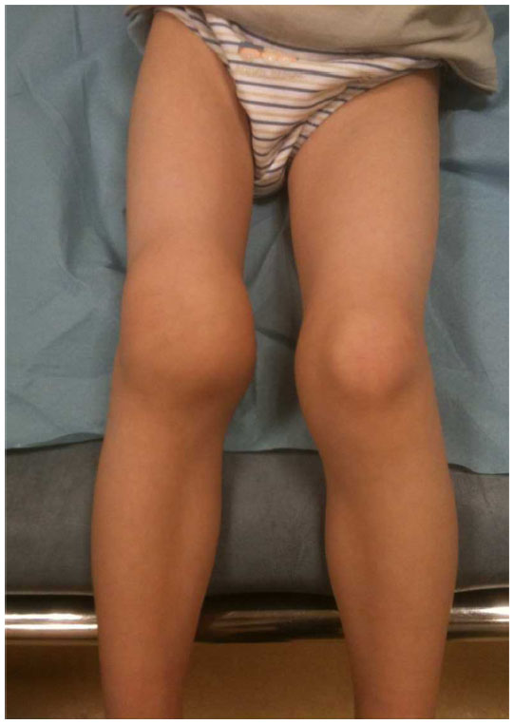
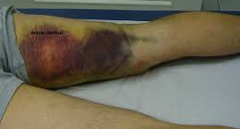
von Willebrand disease (severe)

Slide 22
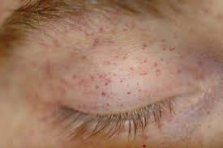
Platelet dysfunction/Thrombocytopenia

Slide 23
Hemophilia A/B

Slide 24
Hemophilia A/B
mild
> 5 % - 40%
severe
< 1 %
moderate
1 - 5 %
mild trauma
surgery
(PROPHYLAXIS)
“spontaneous” joint/muscle bleed
trauma, surgery
PROPHYLAXIS
trauma
surgery

Slide 25
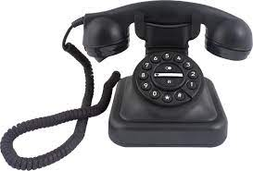
What should I do in case of surgery?

Slide 26
Treatment options (prevention)
platelet transfusion
coagulation factor replacement therapy
Exacyl® orally/intravenously
DDAVP

Slide 27
Exacyl® = tranexamic acid
antifibrinolyticum
dose:
100 mg/kg/day in 3-4x PO or continuous IV infusion
may be used locally
Notes:
Opname tussen 2e en 3e uur maar weg na 6u (eliminatie halfwaarde 3u)

Slide 28
DDAVP = minirin
release of factor VIII or VWF from endothelium after +/- 30 minutes
dose: 0.3 µg/kg over 30 min IV (max 20 µg)
mild hemophilia A and von Willebrand disease type 1 (and 2), older than 2 yrs – after test

Slide 29
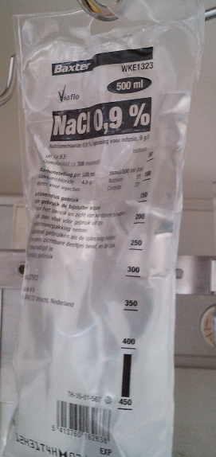
DDAVP

Slide 30
What should I not do?
no intramuscular medication…
no arterial line or DVC…
no lumbar puncture…
... without correction of hemostasis before
no local anesthetic with adrenaline

Slide 31
Take home messages…
Primary vs secondary hemostasis
Consider a possible congenital bleeding disorder based on history, even if screening is normal (vs young children)
Consult (pediatric) hematologist prior to every invasive procedure/surgery/tooth extraction
Notes:
young children: history is short and screening may be outside normal range but “normal for age”

Slide 32
Thank you for your attention…

