Slide 1
Postoperative Pain in Children available resources during the perioperative period
Dr Th. Pirotte
Pediatric Anesthesia
Cliniques Universitaires Saint-Luc - Brussels
President of the BAPA

Slide 2
Perioperative Pain in Children
Multidisciplinary approach
Pre- ,per- , post-operative continuity
Institutional protocols (validated by Anesth, Ped, Surgeon)
Flexibility : evolution, special care

Slide 3
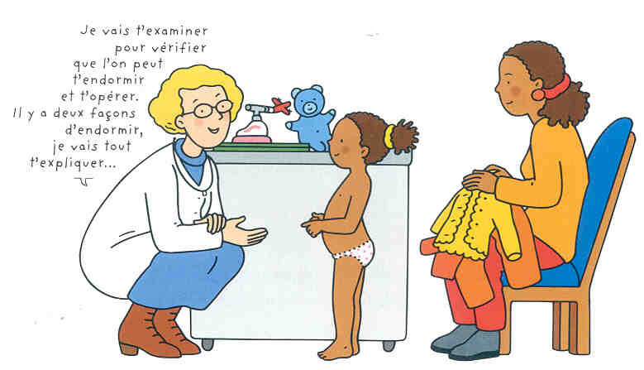
Anxiety or lack of information
Pre-operative anxiety increase post-operative pain
Parental anxiety increase anxiety of the child
Separation anxiety in young children
R/ anxiety
Information & Support
Parental presence
Distraction
Dedicated staff

Slide 4
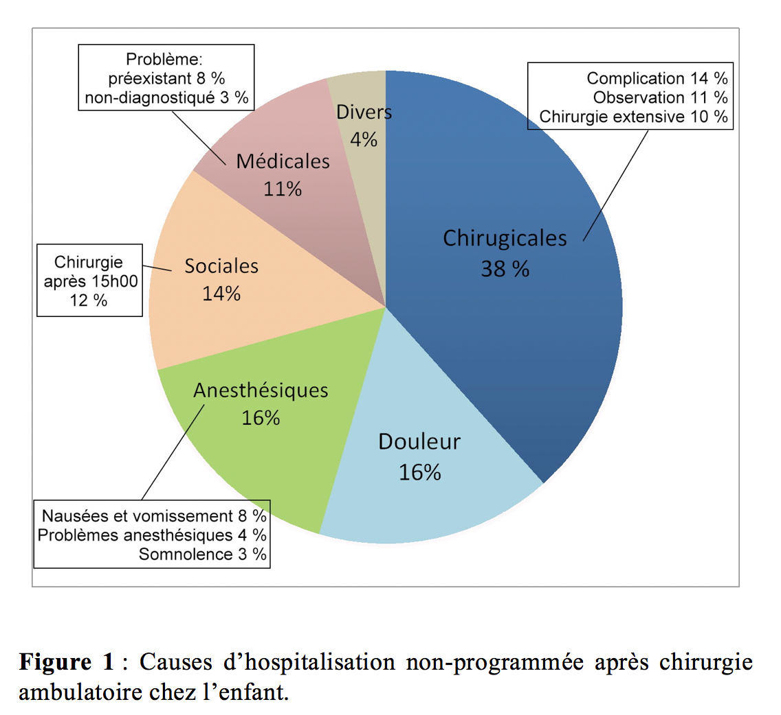
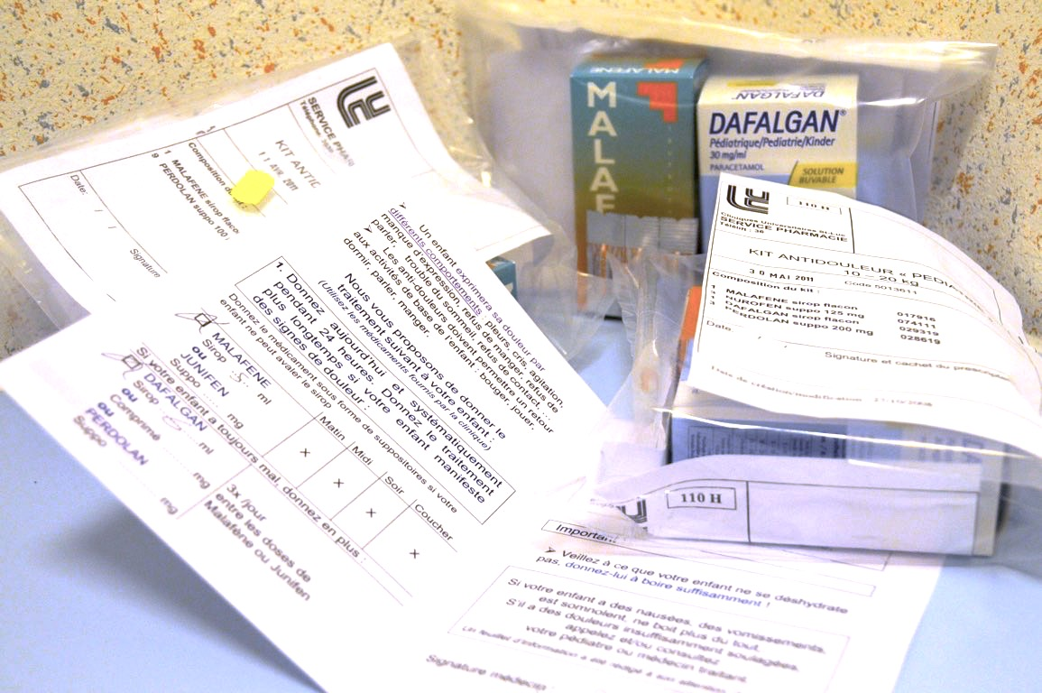
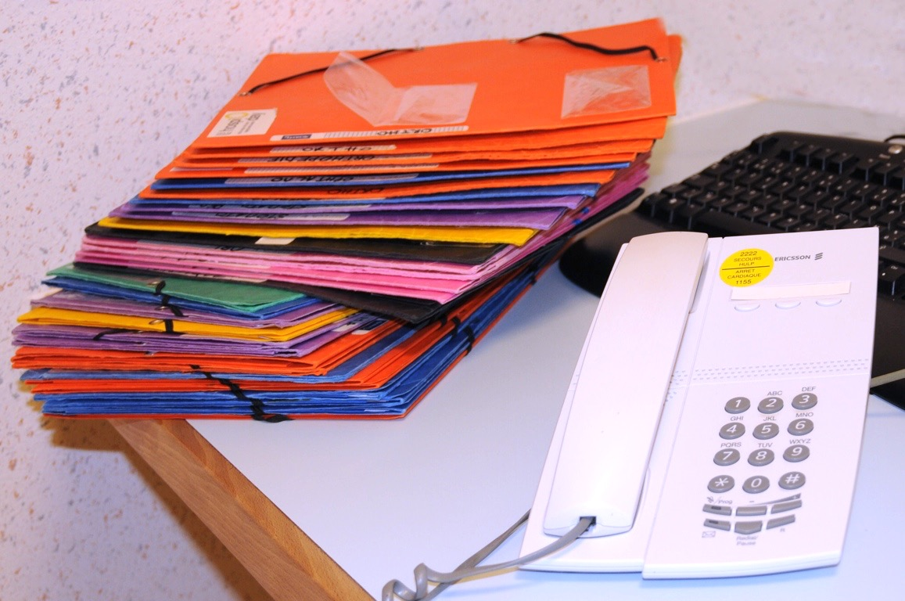
Information and Support
Ambulatory surgery : up to 70%
Parents = caregivers
Written & Oral information
Pain rating scale for home *
Phone calls

Slide 6
Parental presence
Organisation, habits……

Slide 7
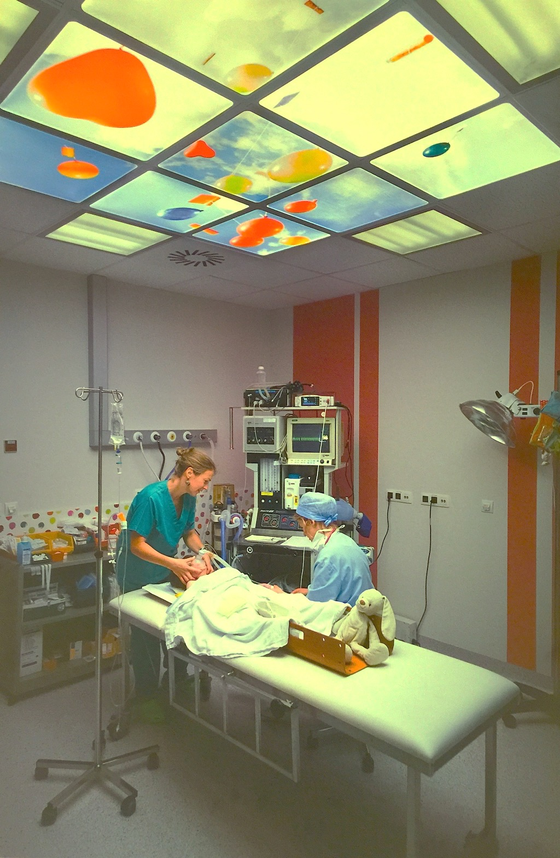
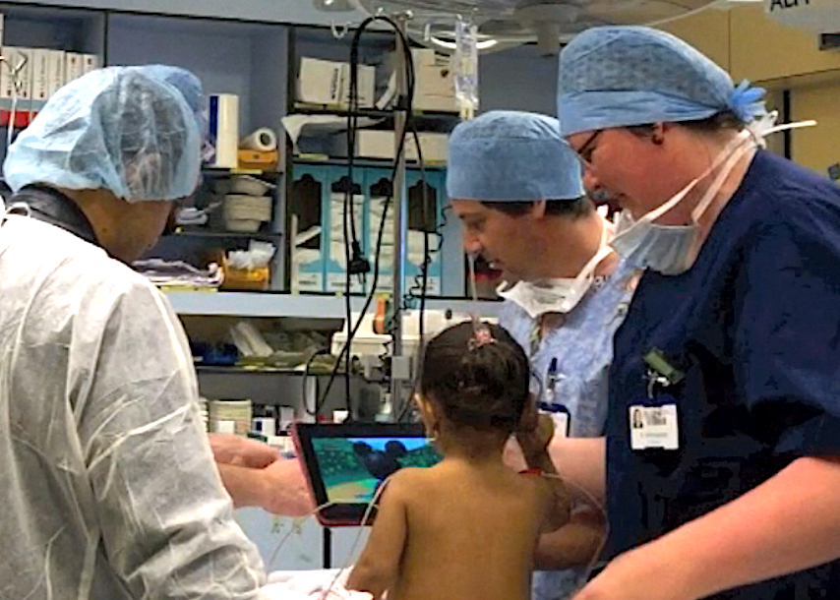
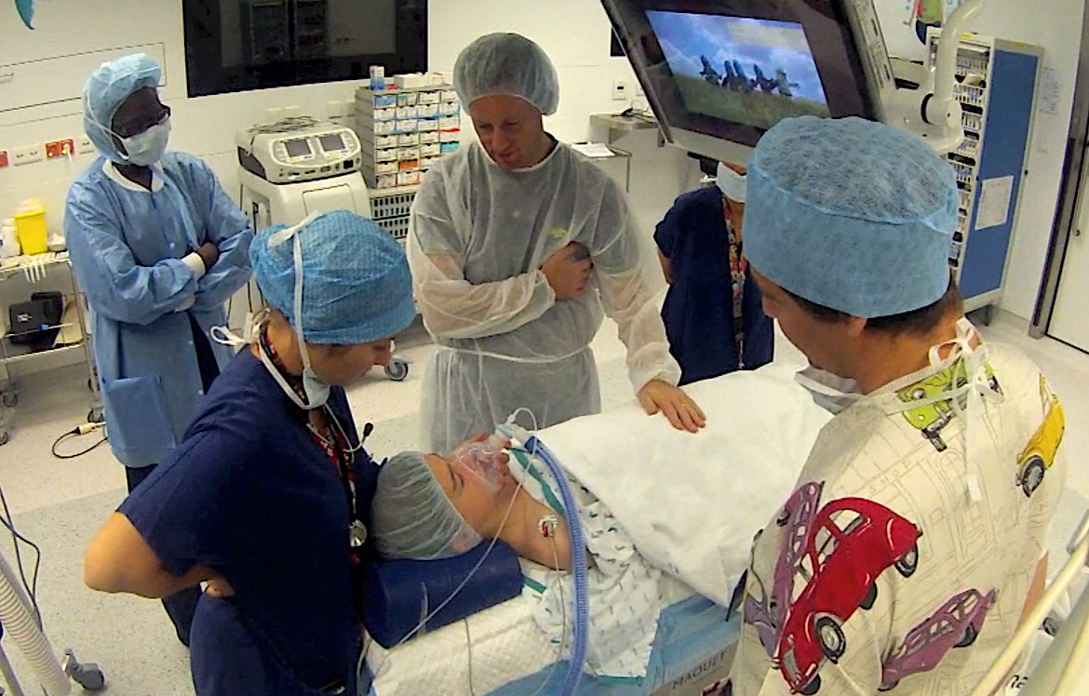
Distraction techniques

Slide 8
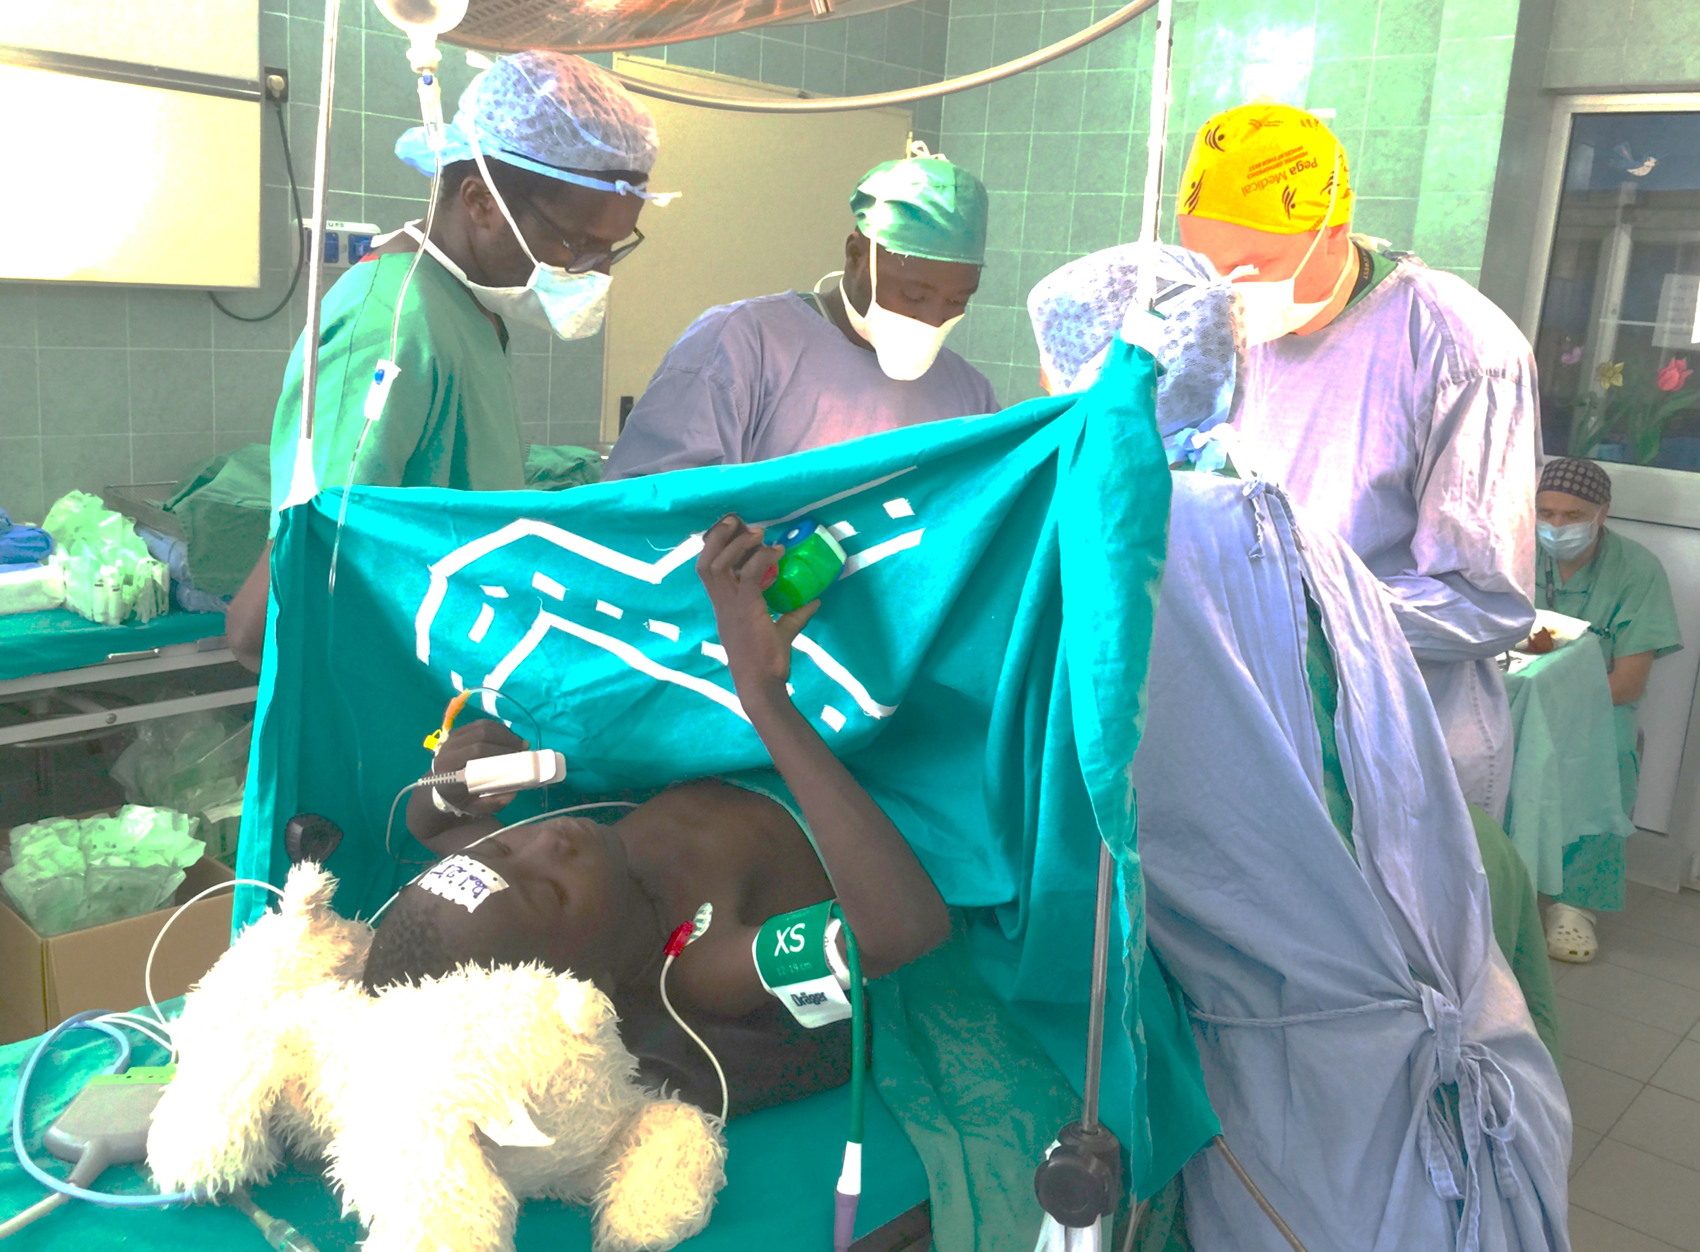
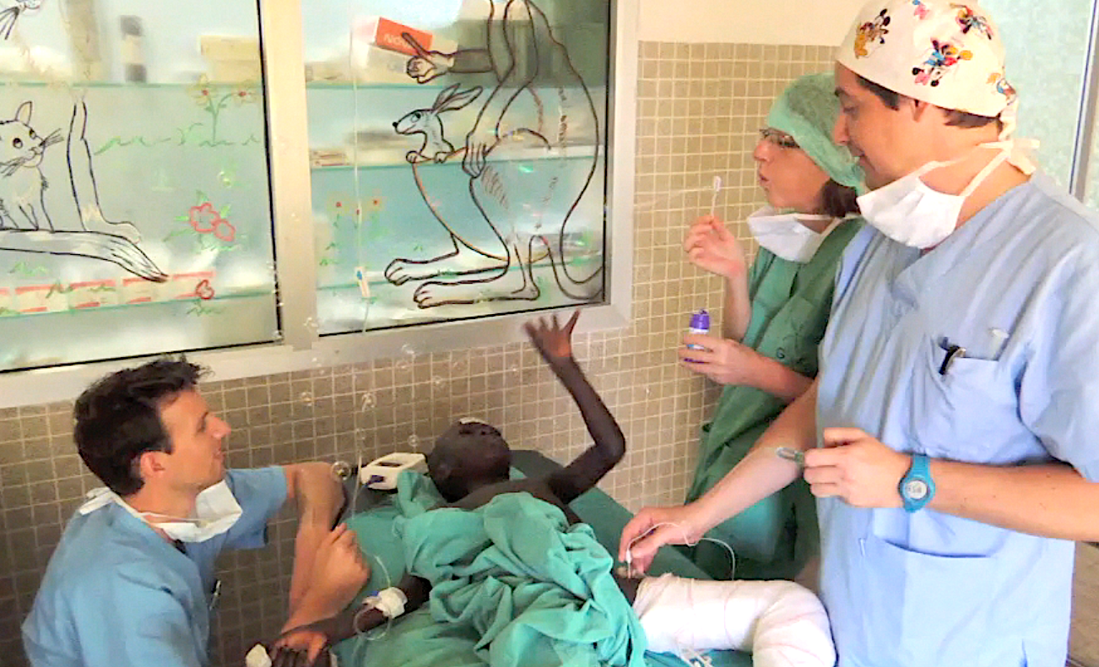
Distraction techniques

Slide 9
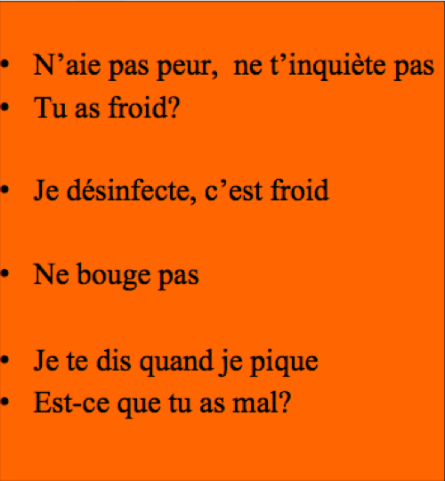
Dedicated Staff (pre-, per-, post-operative)
Friendly contact with children
Verbal
Paraverbal
Therapeutic communication
Distraction
Hypnosis
Les « Gros Mots »
Les « Mots Doux »

Slide 10
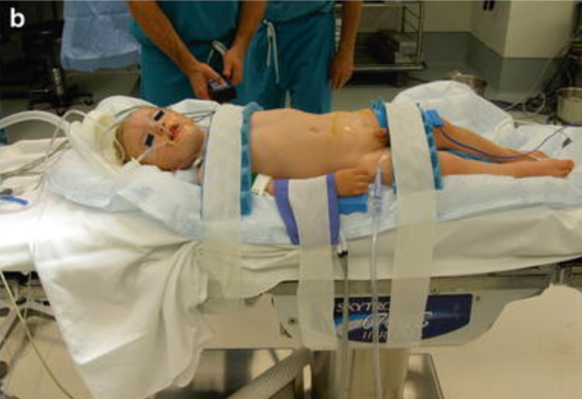
Per-operative Management
“Multidisciplinary” discussions
“Invasivity” of the surgery
Temperature (room, fluids)
Positioning operating table
Compression points (heels, nerves)
Stretching plexus (arm, leg)
Flexion of joints (neck, hip)
Anesth
Surgeon
Notes:
Invasivity >> length

Slide 11
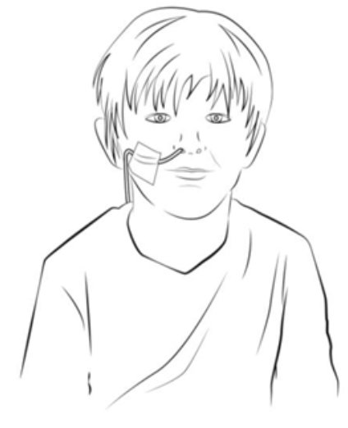
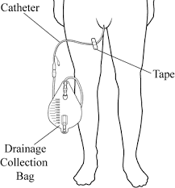
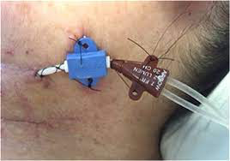
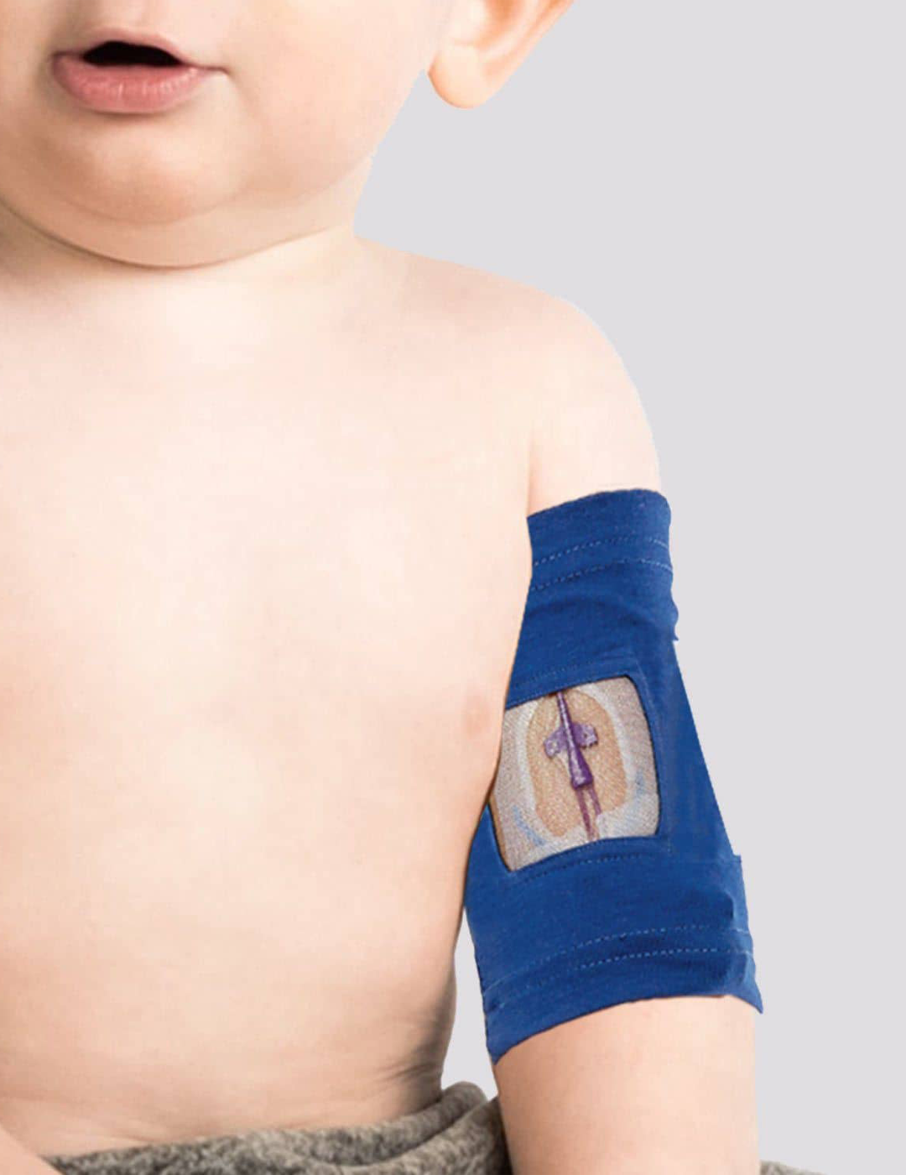
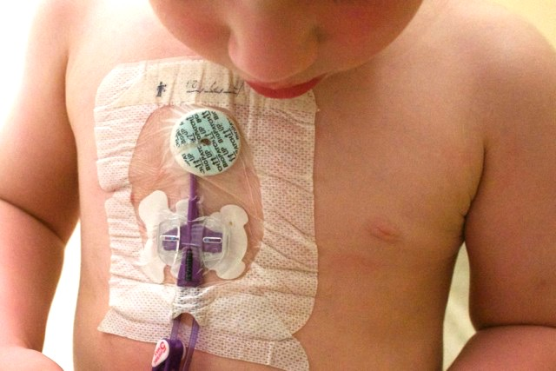
Avoiding postoperative catheter-related discomfort
Naso-Gastric Tube
mandatory ?
Urinary Catheter
mandatory?
Central Venous Catheters
mandatory ?
area ?
fixation ?

Slide 12
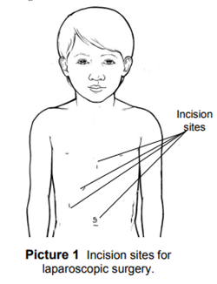
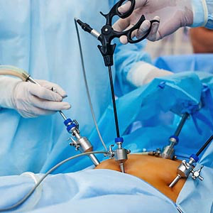
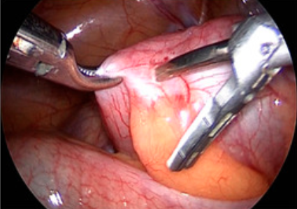
Minimal invasive Surgery
Cosmetics
Less inflammatory response
Less risk of adhesive intestinal obstruction
Less pain
Faster mobilization
Shorter hospital stay

Slide 13
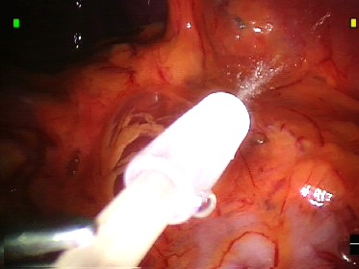
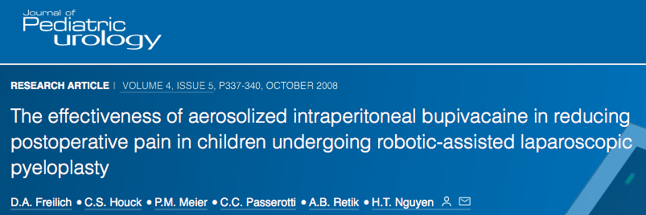
Minimal invasive Surgery
Wound infiltration
Intra-abdominal nebulisation of LA’s
Less postoperative pain
Reduced shoulder pain
Earlier mobilization

Slide 14
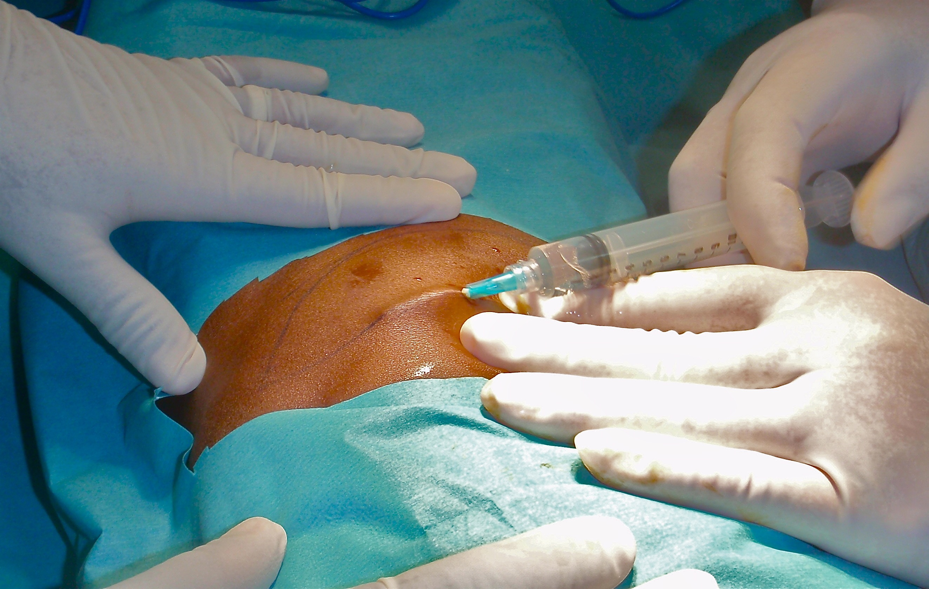
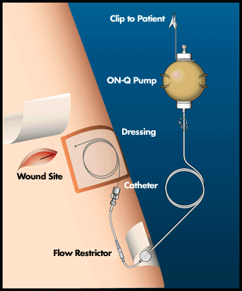
Classic open Surgery
Laparotomy : Transverse > Longitudinal (midline)
Limited adhesiolisys
Wound infiltration (pre-incisional > at closure) *
Wound catheters for continuous infusion **
*
**

Slide 15
Pediatric Anesthesia
Allow minimal invasive surgery
Multimodal Anesthesia & Analgesia
Central & Peripheral Nerve Blocks
Initiate postoperative prescriptions

Slide 16
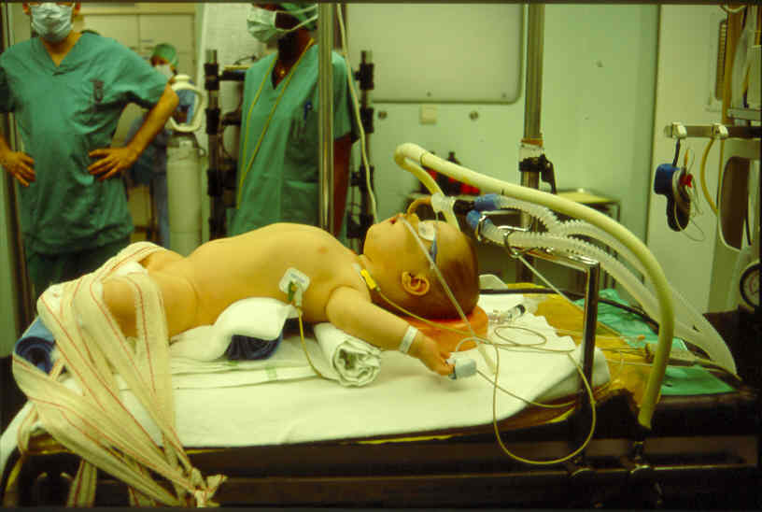
Anesthesia for Laparoscopic Surgery
Minimal invasive = minimal access to the child
Small wound ≠ shorter surgery …
Raise in intra Abdominal Pressure (CO2)
respiratory effects
hemodynamic effects
Risk of gaz embolism (CI)

Slide 17
Pain after Laparoscopic Surgery
Early postoperative pain still present
Shoulder pain
Can be reduced by
- reduced insufflation pressure (Neo < Ped < Ad)
- good anesthesia & muscle relaxation
- complete gaz exsufflation at the end
- NSAID
- opiates

Slide 18
Multimodal Anesthesia
Opioids +++ ➜ hyperalgesia
Multimodal anesthesia
Combining ≠ molecules ≠ pathways
Low dose Opioids + NSAID, alpha2Ag, Mg,…
More effective
Less side effects of each drug

Slide 19
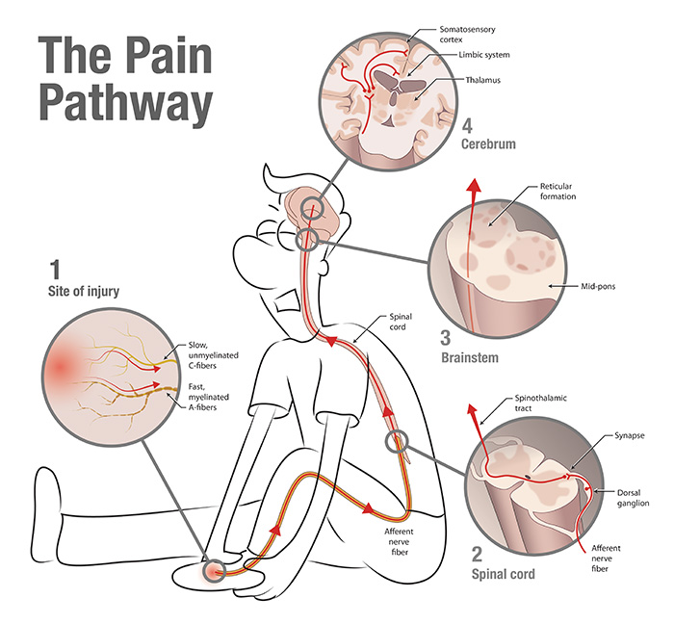
Nerve Blocks
placing Local Anesthetics around nerves
close to the vertebral column
around peripheral nerves or roots
in planes between muscle layers
to blocks the painful stimulus before it reaches the brain
pain relief at rest (less PONV) & at movement
local anesthetic once or continuous infusion (catheters)
Duration of action:
( x AL concentr - adjuvants)
- caudal : max 6h
- peripheral NB: max 12h
- abdominal wall B: max 18h

Slide 20
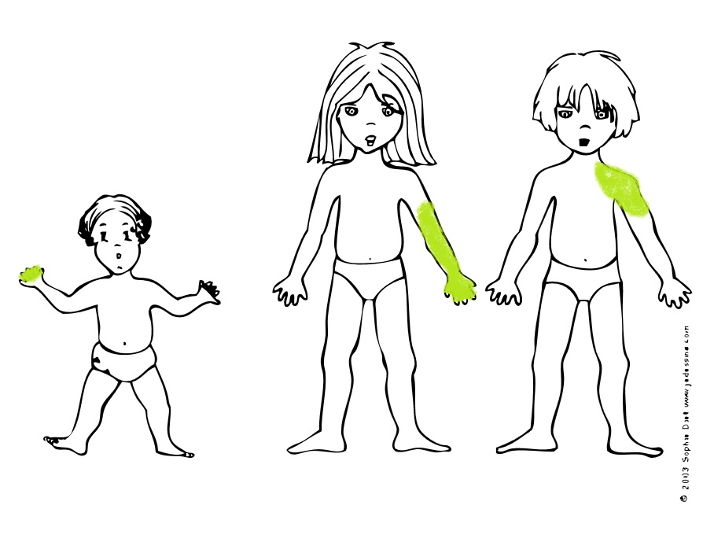
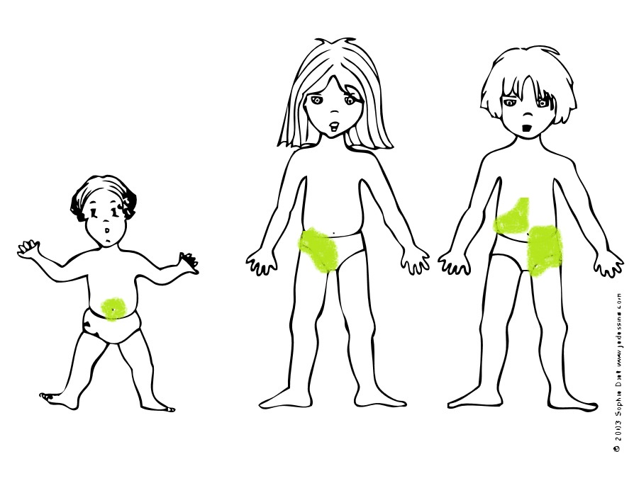
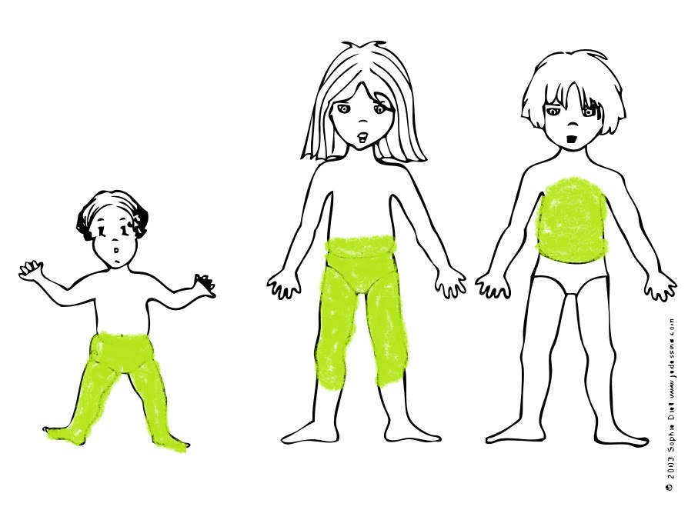
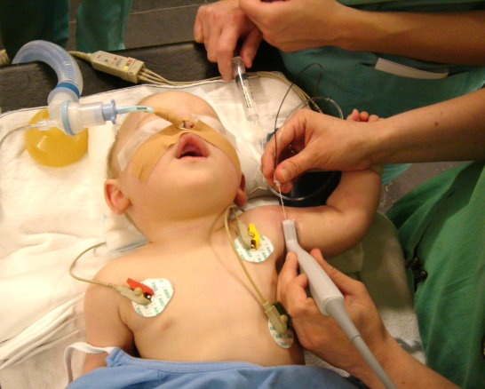
Nerve Blocks in Children
Peripheral Blocks
finger
wrist
axillary
interscalenic
femoral
sciatic
para-umbilical
ilio-inguinal
TAP
Central Blocks

Slide 21
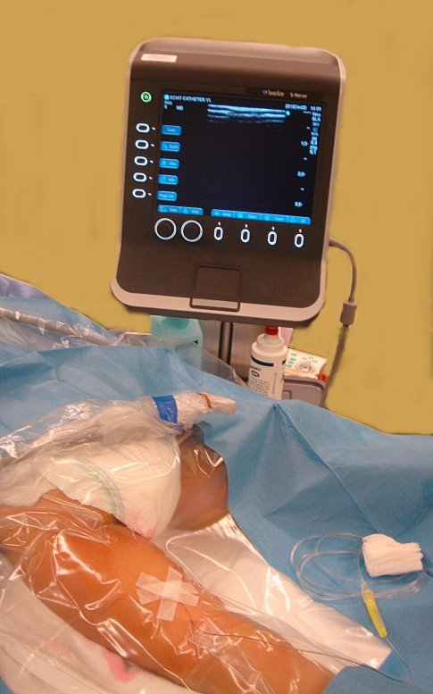
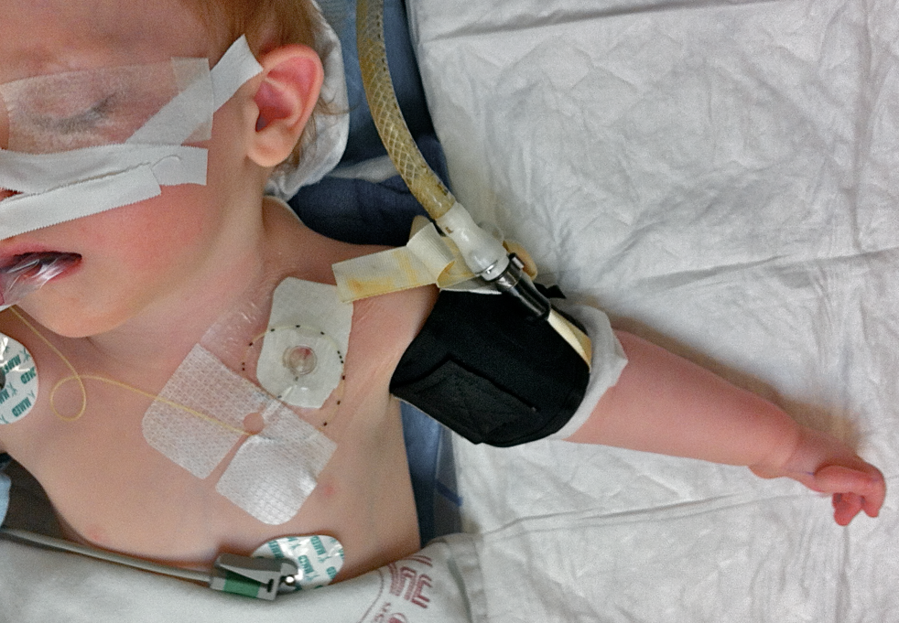
Nerve Blocks in Children
Catheter
Peripheral Blocks
finger
wrist
axillary
interscalenic
femoral
sciatic
para-umbilical
ilio-inguinal
TAP
Central Blocks

Slide 22
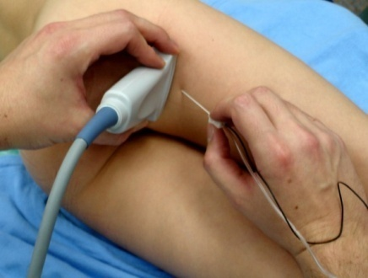
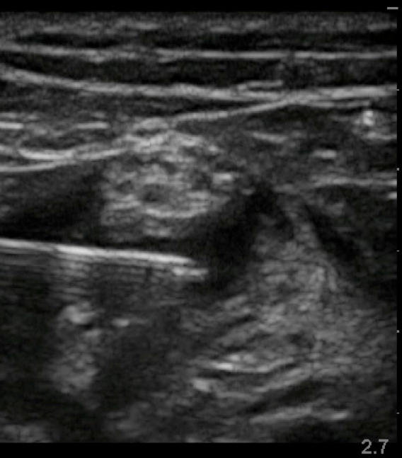
Nerve Blocks
Are Safe
no mortality
no long lasting morbidity
! LA’s potential toxicity
Can be performed under Anesthesia
Are performed under US guidance
European & American studies
20.000 to 30.000 blocks in children

Slide 23
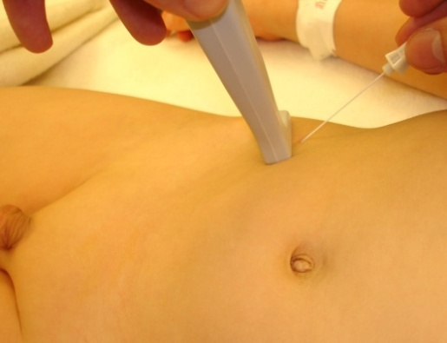
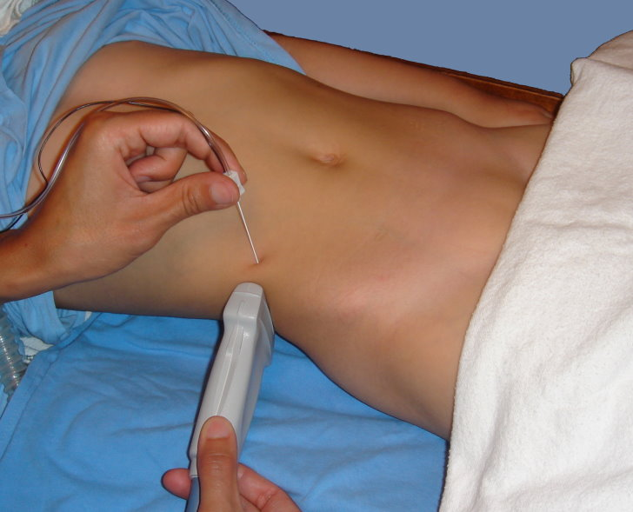
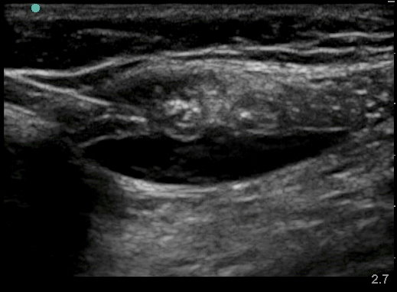
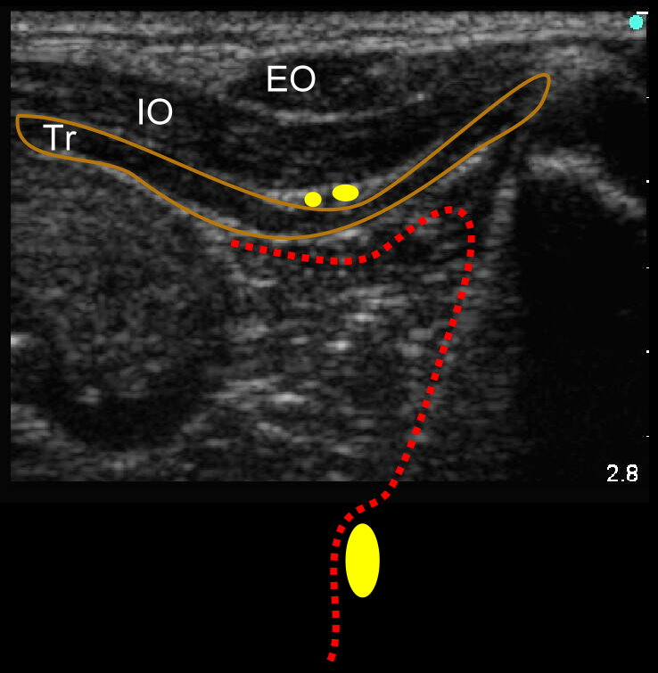
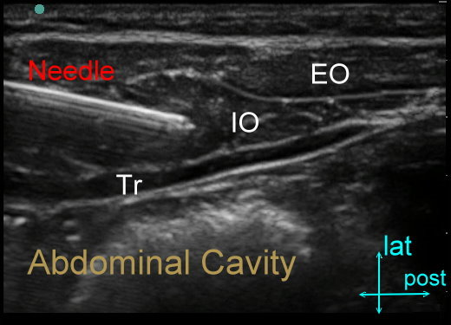
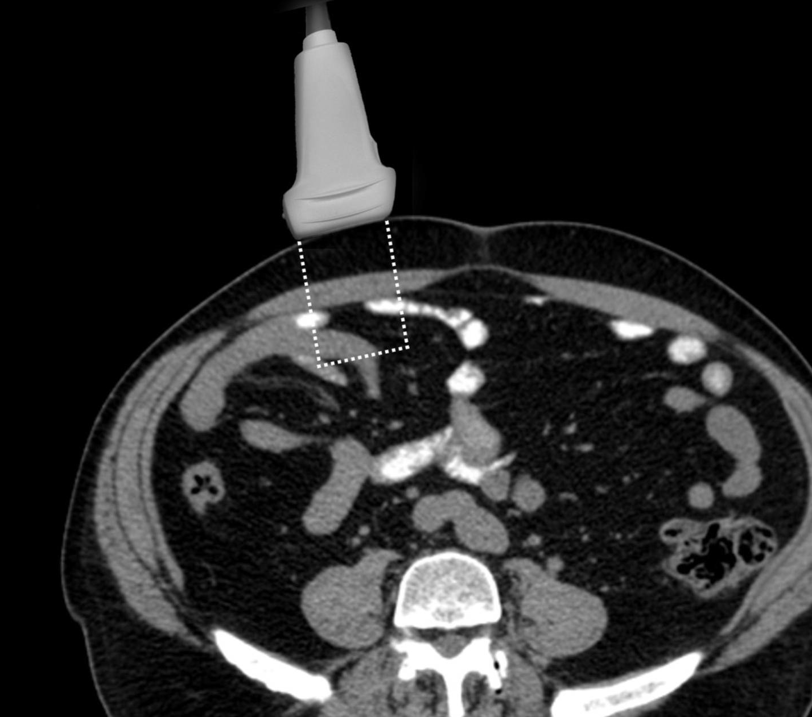
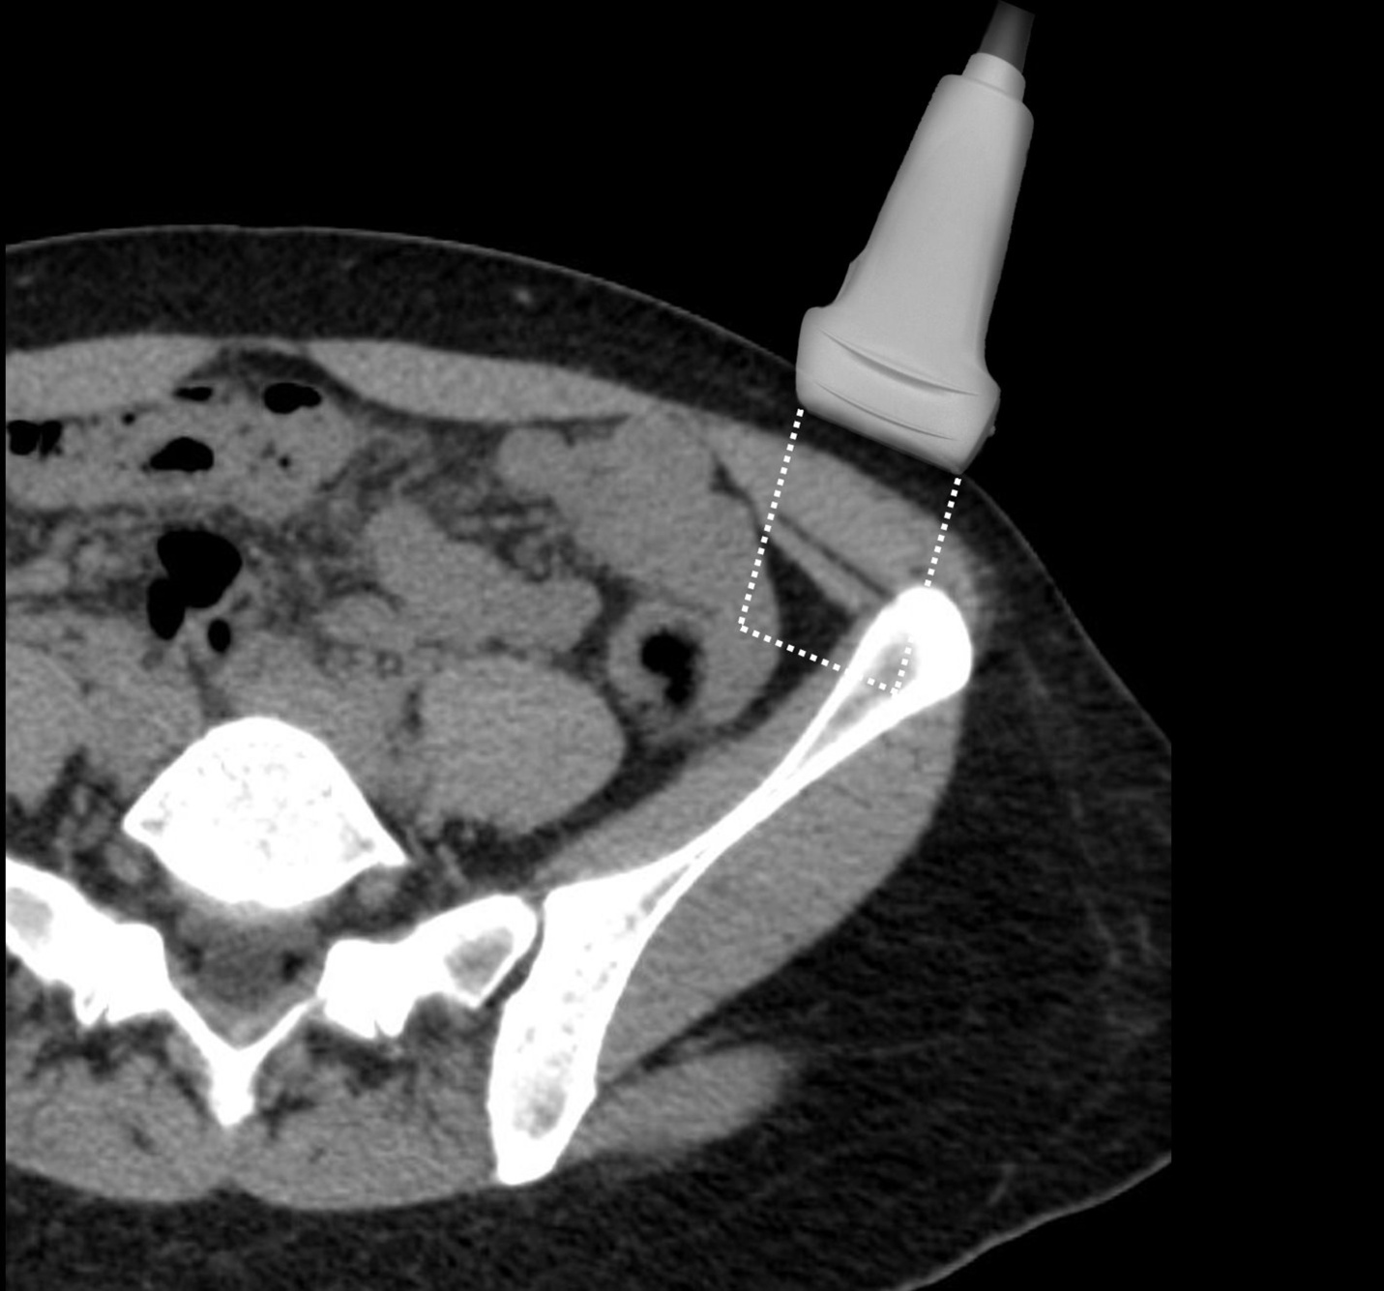
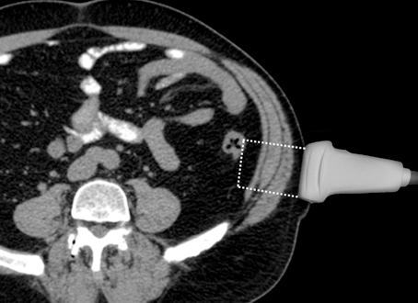
Abdominal Wall Blocks
Para-Ombilical
ilio-inguinal
TAP

Slide 24
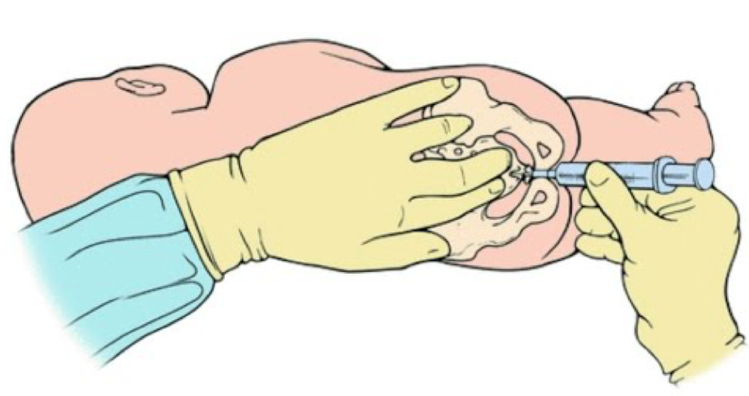
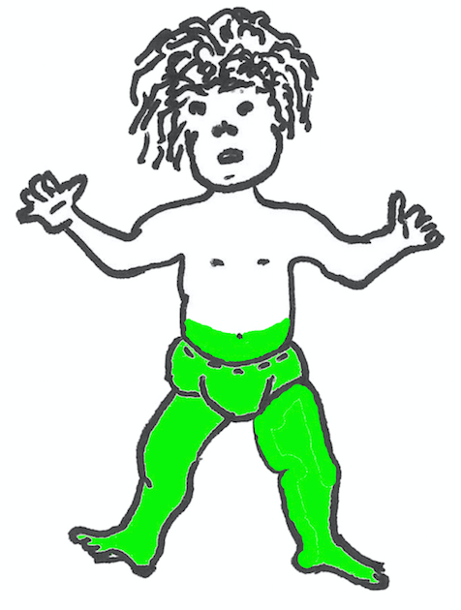
Caudal Block
= single shot Epidural block
0 to 6 years old
Infra-umbilical surgeries
Anesthesia: 2 h, Analgesia: 6 h
Voiding ok (daycases)

Slide 25
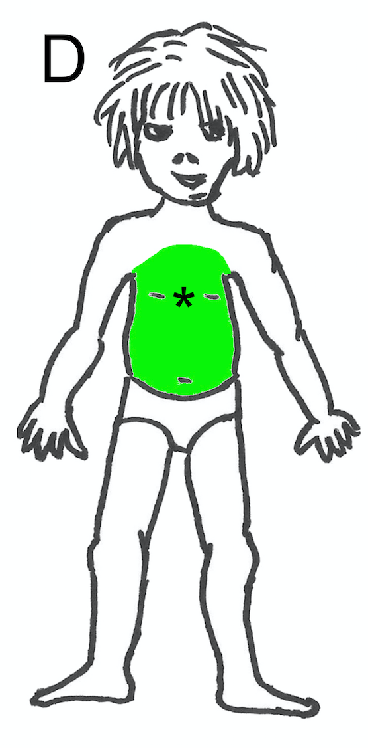
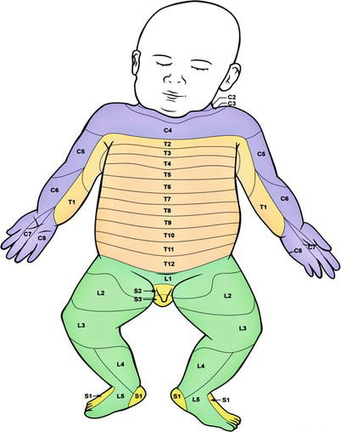
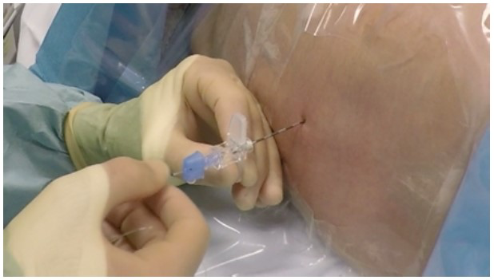
Epidural catheter
Experience in young children & neonate !
Level = level of incision
“Hanging” analgesia
thoracic KT : bladder ok
Extremely rare Infections
postop fever ≠ withdrawal

Slide 26
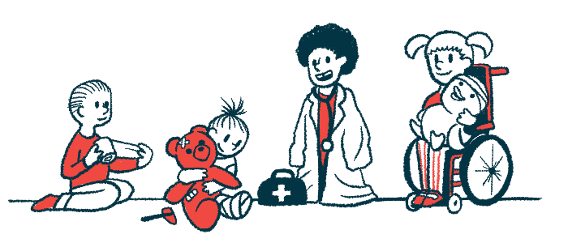
Postoperative Prescription
Multimodal
PCM
PCM + NSAID
PCM + NSAID + Tramadol
PCM + NSAID + Opioids
PCM + NSAID + Opioids + alpha2 Ag / keta / …
! After a single shot Nerve Block
! During a continuous Nerve Block

Slide 27
After a single shot Nerve Block
Avoiding « tears at bed time »
send home pain–free without any prescriptions
+++ pain when limb wakes up
Estimate the duration of the nerve block
Analgesics prescription & advices
Analgesics preventively
« by the clock » , not « if needed »
Tramadol or opioids in case of extensive surgery

Slide 28
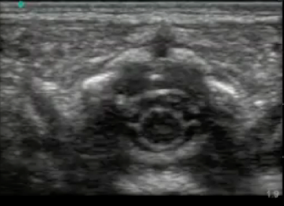
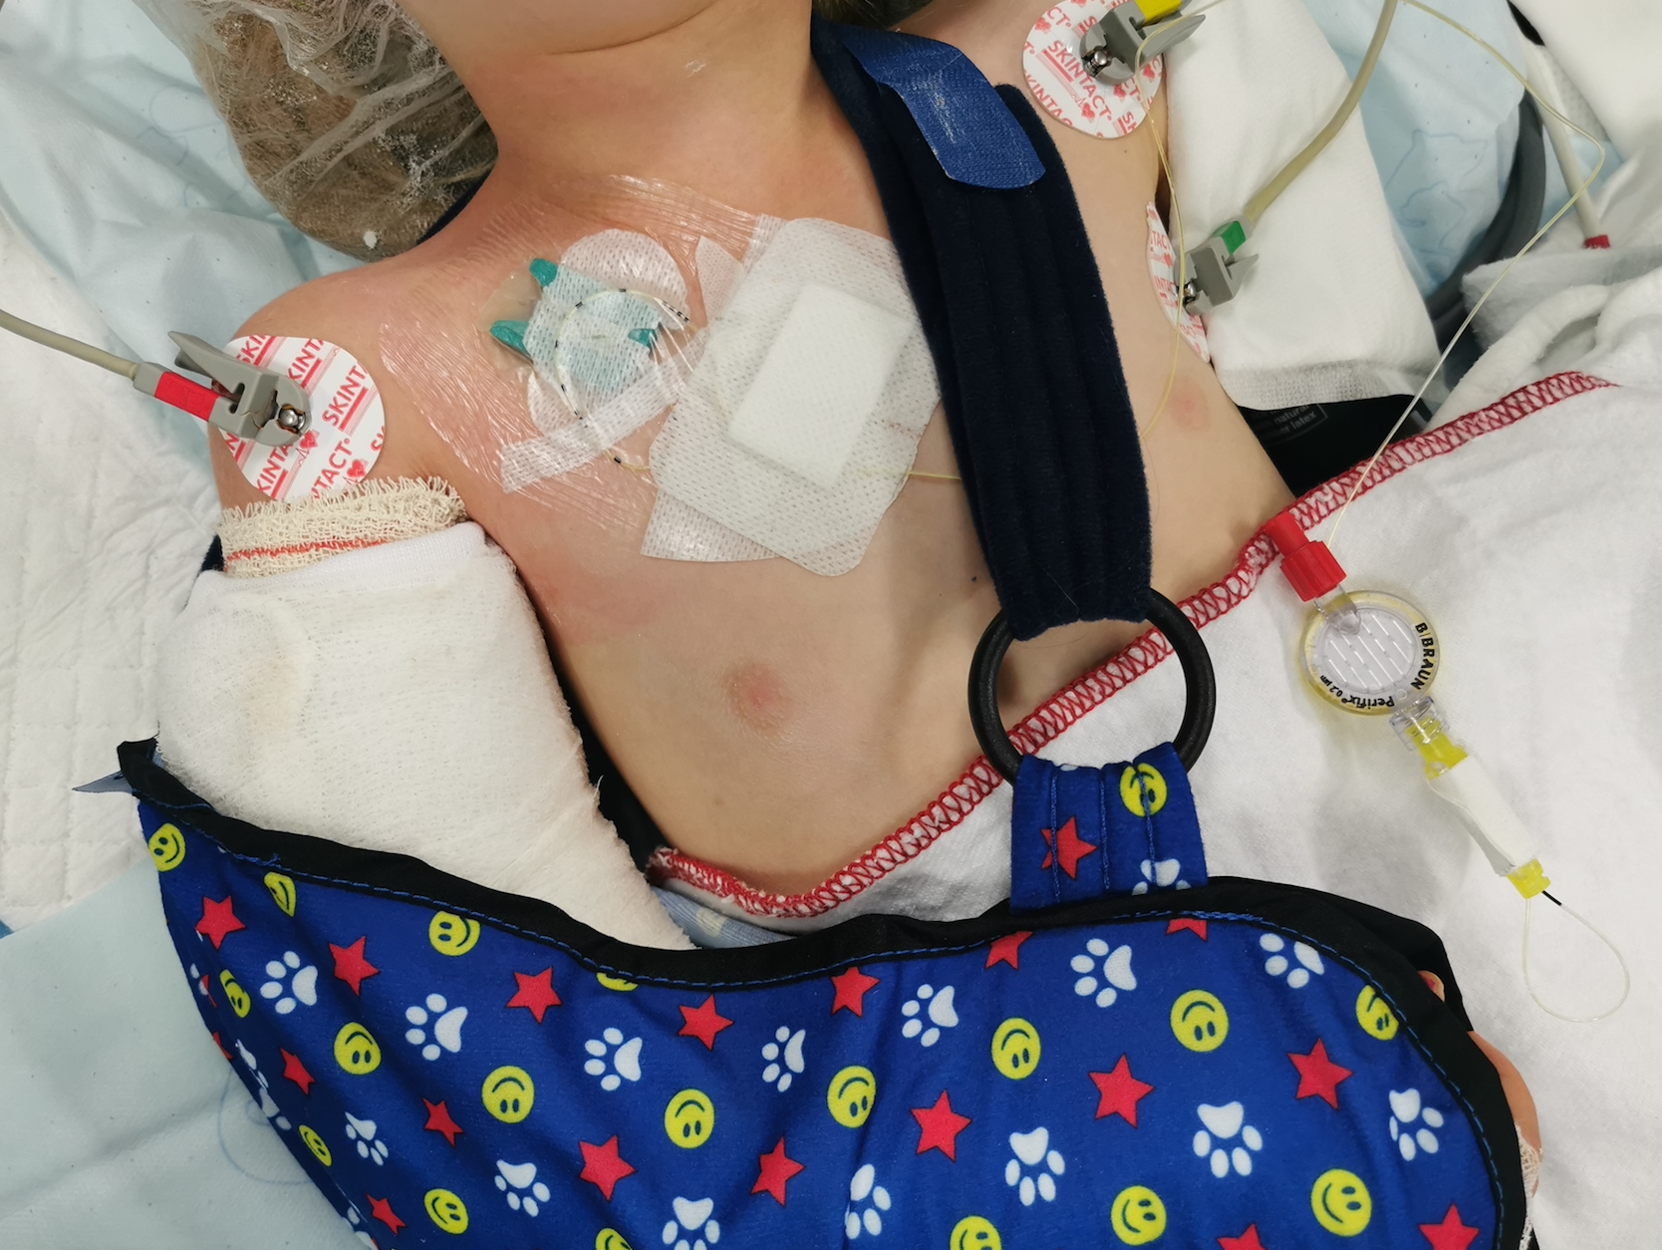
During a continuous Nerve Block
Technical issues : Neonates > Children > Ad
Catheter kinking, leakage, withdrawal,…
Team 24/24 - 7/7
Switch to opioids if failure 24/24 – 7/7

Slide 29
To Conclude…

Slide 30
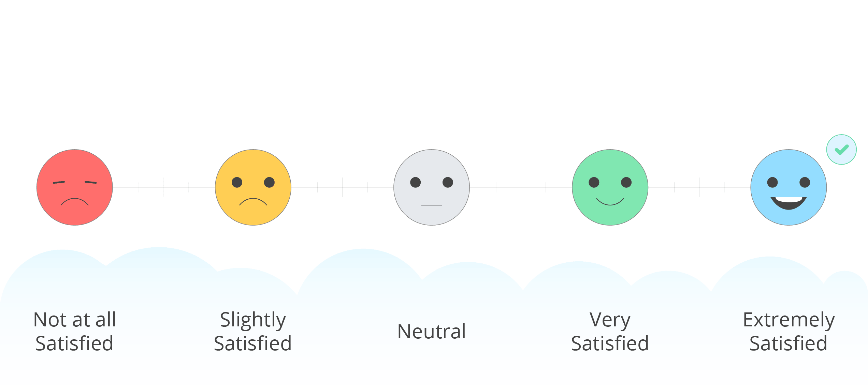
Anesthesia ≠ only performing Nerve Blocks
Preoperative preparation
Discussion with surgeon
Apply analgesic protocoles (Ped, nurse)
Early prescriptions & advices
Follow up & Team work

Slide 31
Thank you for your attention
t.pirotte@saintluc.uclouvain.be

